Slide 1
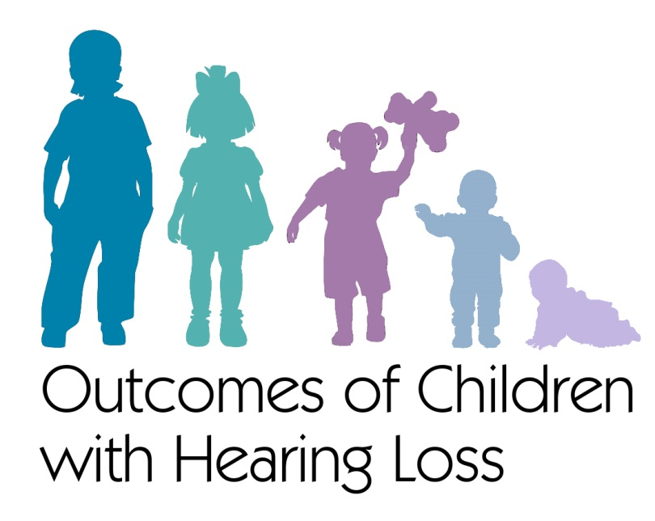
Narrative Skills in School-Age Children who are Hard of Hearing
Elizabeth Walker, PhD, CCC-SLP/A
University of Iowa, Iowa City, IA
Kathryn Gabel, BA
University of Iowa, Iowa City, IA
Mary Pat Moeller, PhD, CCC-A
Boys Town National Research Hospital, Omaha, NE
Supported by NIDCD R01 DC009560, R01 DC013591
Early Hearing Detection and Intervention Annual Meeting
March 5, 2019
Notes:
Acknowledge my co-authors

Slide 2
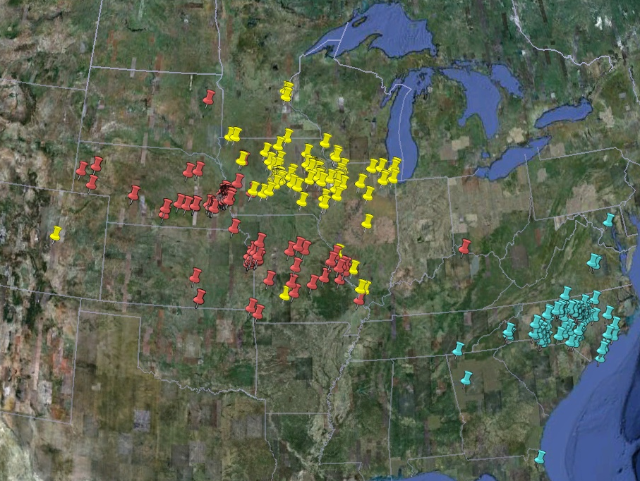
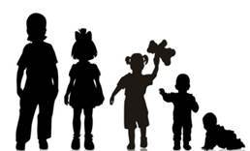
The OCHL study is a multicenter, longitudinal study focusing on outcomes of children with mild-severe hearing loss
SUBJECTS | TOTAL
HH | 317
NH | 117
Notes:
Some background on the project. Children were between the Ages of 6 months to 7 years at entry into study, English is primary language spoken in the home, No major secondary disabilities, No cochlear implant, Permanent mild to severe bilateral hearing loss. 3 sites – iowa, BT, and UNC, 16 different states in the US – resulted in 316 children who were HH and a NH control group matched by SES and age

Slide 3
Who are the OCHL participants?
 | CHH | CNH | Both Groups
Number | 317 | 117 | Matched on income & maternal education Higher than typical US sample
Gender | 173 male; 144 female | 54 male; 63 female
Hearing | M= 48.88 dB HL 7 without amplification 76% identified from NHS | < 20 dB HL
Inclusion criteria
6 months to 7 years at entry
English primary language
No major secondary disabilities
No cochlear implants
Permanent mild to severe bilateral hearing loss
Notes:
Subject numbers- 317 CHH- matched to 117 CNH
CHH Mean BEPTA = 48.88 dB HL, here is the distribution of sample by degree of HL; only 7 children were not fit with amplification (mild degree of loss); 76% referred from NHS – largely EI group
HH matched to NH on maternal ed/SES, although higher than average US rate for maternal ed. Common issue in longitudinal studies which rely on continued participation over a number of years.
Fortunately, attrition was minimized to 9.78%; Geographic distribution shown here…came from 17 states

Slide 4
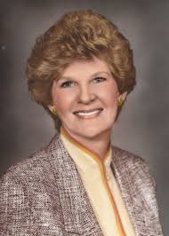
Why are we interested in children who are hard of hearing?
“Hard of hearing children are not easily recognizable and often are mistaken for children with vague, sometimes exotic, always bewildering problems. Thus, in many educational systems they are invisible children.”
Julia M. Davis
“Our Forgotten Children”
1977
Notes:
Grant agency (NIH) recognized that they had funded many studies related to sign language and to the use of cochlear implants in children
In contrast, research on children who are HH quite limited---
Typically small samples or samples that include both D/HH, making in challenging to draw conclusions about unique needs of HH group
Measures varied; conclusions varied
Major need to understand children’s performance with Has & few studies addressed this
Because of NHS, we have an opportunity to study these children much earlier in life – that is essential to understanding how service innovations are impacting development
Grant was defined to focus on a population based sample of children who are HH who are learning spoken language (not a value judgment – our team has strong value and respect for ASL as well as other approaches, but this grant was focused on children who are HH learning spoken language – how are they doing?)

Slide 5
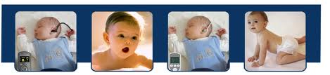
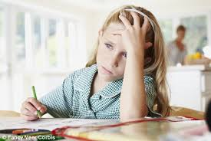
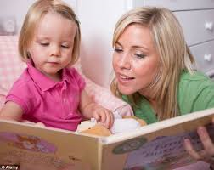
What guided the research goals of this multicenter study?
New generation of children who are hard of hearing
Are these children at risk for delays?
  What are factors that lead to success?
Notes:
What guided the research goals for this multicenter study?
Big picture: When we talk about young children, our interest is in how they learn from the language exposure they receive all around them
1. Well established that the amount of talk and qualitative dimensions of the talk from parents contributes to children’s auditory linguistic experience and language learning. Early language exposure shapes children’s linguistic development
2. It is reasonable then that we work to provide children with optimal audibility through appropriately fit HAs, which will give them access to the language models around them to promote their development
3. We are working with a new generation of babies – who are id’d through NHS and have early access to contemporary hearing technologies and earlier intervention
Some of the questions we want to address as part of the OCHL project
How are these children doing as a result of earlier interventions? What are barriers to receiving intervention?
Also interested in issues of language ACCESS and whether we see factors that interfere with access and increase risk. Relates to the audibility that children receive from hearing aids, and how often they are using hearing aids.

Slide 6
Domains of study
Higher-level language: Narratives
Child and Family Outcomes
Background characteristics of child/family
Hearing & Speech Perception
Speech Production
Language Skills
Psychosocial and Behavioral
Interventions (clinical, educational, audiological)
Academic Abilities
Notes:
Brown = child and family outcomes, arrows both ways due to family influence on outcomes, but also the influence of the domains on the child/family
Measures – speech perception, speech production, language, academics, psychosocial and behavioral

Slide 7
Why are we interested in narratives?
Good narrative skills = the ability to effectively tell a story
Most classroom material conveyed in language beyond the sentence level
Early narrative skills predict reading development and impact later academic success
Few studies have focused specifically on children with mild-moderately severe hearing levels

Slide 8
Previous literature: Ambiguity about risk posed by mild to severe hearing loss for narrative skills
Note:
Focus on children who are deaf or combined D/HH
Wide age range
Delayed relative to peers | n | Age (yr) | Status | Like typical peers | n | Age (yr) | Status
Worsford et al. (2010) | 89 | 11-15 | D/HH | Reuterskiold et al. (2010) | 18 | 9-13 | HH
Boons et al. (2013) | 66 | 5-13 | Deaf | Asker-Arnason et al. (2012) | 20 | 10-18 | HH
Soares et al. (2010) | 21 | 5-11 | D/HH | Arfe (2015) | 42 | 7-15 | D/HH
Notes:
If we look at the historical literature on CHH, there is ambiguity about the level of risk that is posed by mild to severe hearing loss
Studies listed in the blue columns conclude that ANY degree (including mild) places children at risk, especially in phonology and syntax
Studies in purple conclude that many CHH perform like hearing peers and better than children with Language Impairment although some individual children show impaired skills, especially in phonological processing
Notice that the n’s in these studies were small, typically involved school age children.
Also, studies did not consider the impact of hearing aids on children’s development

Slide 9
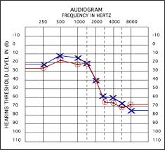
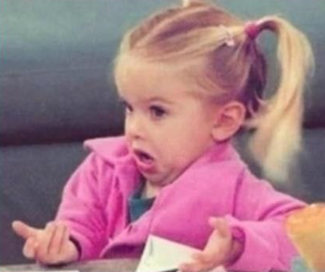
Hypothesis #1: Consistent access to speech will predict success for children who are HH
Most previous research looked at the association between degree of hearing loss and outcomes with mixed results
Notes:
We’ve talked about auditory access with age at identification, and HA compliance. Another area of interest is variability in audibility (or how much of the speech spectrum is audible), and how that affects outcomes. Although this seems obvious (children with more access to the speech spectrum will have better outcomes), it’s another area (like HA use) that has been overlooked in research studies. Most of the focus has been on using pure tone average as a predictor of outcomes, but those studies that used PTA as the predictor with HH children are mixed – some studies have found that children with more severe losses do worse on different language measures, and other studies do not show a relationship between degree of hearing loss and outcomes. This seems counter-intuitive – but keep in mind that these studies are looking at kids based on their unaided thresholds, which is not how they are walking around in the real world. Comes back to cum. Aud. Exp. : how long they have had their hearing aids, how often they are wearing them, and how much speech is audible via the hearing aids. Will focus on this audibility issue now.
HOW to quantify access = SII

Slide 10
OCHL outcomes model: cumulative auditory experience hypothesis
Audiological Intervention
Aided Audibility
Hearing Aid Use
Outcomes
Degree of HL
(PTA)
Factors that moderate relationship between PTA and outcomes.
Notes:
Define CAE. Studies in the past have generally examined the impact of hearing loss (mostly degree) on children’s outcomes…and the results are mixed. However, pure tone average has had mixed results predicting variability in outcomes with some studies finding greater pure tone averages associated with poorer outcomes (e.g. Sininger et al. 2010) and other studies finding no relationship (Moeller, 2000) or only a relationship with specific developmental outcomes (Ching et al. 2013). Although pure tone average provides a single numerical estimate of the degree of hearing loss, pure tone average does not represent how much the child is able to hear with amplification, particularly since children with the same pure tone average may have varying degrees of aided audibility through their hearing aids depending on how closely the hearing aids are fit to prescriptive targets (McCreery et al. 2013).
We hypothesize that the presence of hearing loss has consequences for children’s cumulative auditory experience…and variations in auditory experience are expected to influence outcomes.

Slide 11
Hypothesis #2: Children who are hard of hearing will experience more difficulty in aspects of morphology, especially high-frequency, low-intensity morphemes
Cumulative auditory experience
Outcomes
Content
Form
Use
Limited perceptual salience + input frequency
Notes:
Added other factors beyond cumulative auditory experience that may also influence child’s development and explain variability in outcomes. Educational intervention, home/community, child cognition, behavior, etc. may all contribute to variability in performance. Some children may be at risk due to their HL and some children may be resilient b/c exposed to protective factors.
Today we’ll explore how audiological intervention influences audibility, duration and consistency of HA use, and how linguistic input relates to children’s development of speech and language outcomes.
Here’s an example of why we want to consider multiple factors instead of a simple variable (e.g., age at HA fitting) in analysis.

Slide 12
Hearing loss affects processing of subtle acoustic cues important for morphosyntax
  Bound morphemes, especially in verbs, are less salient and less frequent in the input
    Typically sentence medial (He needs to find…)
    Often involve fricatives in English
    Complex phonetic contexts (It’s, Greg’s calling…)
Notes:
Form – includes phonology, morphology, and syntax. We predict that all of these areas will be affected by inconsistent access. For example, important morphemes for English (smallest unit of meaning in language) have low phonetic substance, especially verbs. Verbs aren’t highlighted in the input from caregivers (as opposed to nouns), so they are less frequent, they’re usually in the medial position in sentences (regular third person singular tense - /s/ in needs), usually these markers are fricatives, so they’re high frequency/low intensity – esp difficult for most kids with hearing loss, and they’re often in complex phonetic contexts (contractible auxiliary verb is embedded in phrase like “Greg’s calling”).
All of these factors combine to make it difficult for children with hearing loss to develop the aspect of form at the same pace as their peers.

Slide 13
Research Questions and Predictions
Are children who are hard of hearing delayed in narrative skills compared to hearing peers?
CHH < CNH on narrative production and comprehension

Slide 14
Research Questions and Predictions
Does cumulative auditory experience affect narrative skills?
Severe < Moderate = Mild < NH

Slide 15
Research Questions and Predictions
How do children who are hard of hearing compare to age-matched hearing peers on MLU, total number of utterances, and production of high-frequency morphemes?
Percent omitted high-frequency morphemes,
CHH > CNH

Slide 16
Current study: second graders
37 children with normal hearing
  Average age = 8.32 months (SD = .29)
88 children who are hard of hearing
  Average age = 8.45 months (SD = .37)

Slide 17
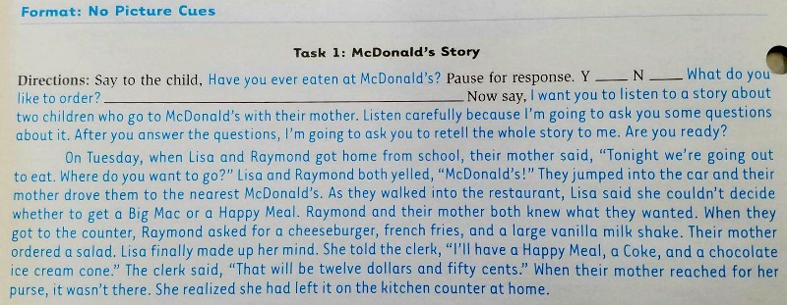
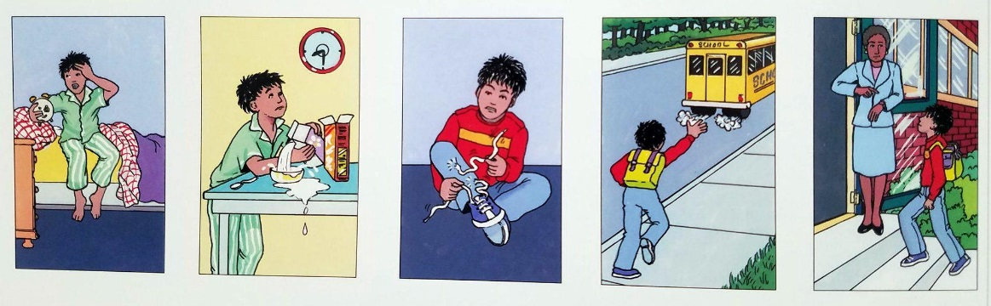
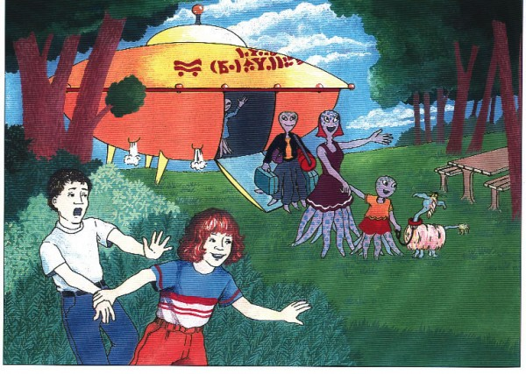
Methods: Test of Narrative Language (Gillam & Pearson, 2004)
“McDonald’s Story”
Retell with no picture support
“Late for School”
Generation with sequenced pictures
“The Alien Story”
Generation with one picture

Slide 18
Methods: Test of Narrative Language
TNL subtests were used to assess narrative comprehension and oral narration.
Oral narratives from the TNL were transcribed and coded in Systematic Analysis of Language Transcripts (SALT) to analyze MLU, total number of utterances, and the percentage of omitted high-frequency morphemes.
  High-frequency morphemes included possessive -'s, third person singular -s, plural -s, regular past tense -ed, and contracted copulas/auxiliaries -’s.

Slide 19
Results: Narrative Comprehension and Production by Hearing Status
CHH scored significantly lower on narrative comprehension than CNH, p = .004.
Differences in oral narration marginally significant, p = .09.
Notes:
Children with NH received significantly higher scores compared to children who were HH on the spontaneous and retell NSS

Slide 20
Results: Impact of CAE on Narrative Comprehension
CNH performed significantly better than children with severe HL (p = .02).

Slide 21
Results: Impact of CAE on Narrative Production
CNH performed significantly better than children with severe HL (p = .01). Children with moderate HL performed significantly better than children with severe HL (p = .02).

Slide 22
Results: Differences in Linguistic Performance in Narratives
Combined three transcribed narratives (McDonald’s story, Late for School, Alien Story) and analyzed in SALT
MLU and Total Number of Utterances were not significantly different between groups

Slide 23
Results: Differences in Linguistic Performance in Narratives
Calculated the percentage of high-frequency morphemes that were omitted in obligatory contexts
Children who are hard of hearing omitted significantly higher percentage of high-frequency morphemes than children with normal hearing (p = .02)

Slide 24
Summary of findings
Mean scores for children who are hard of hearing were within the average range for the test norms.
Comparisons with control group indicated delays in narrative comprehension.

Slide 25
Summary of findings
MLU and number of utterances do not appear to be sensitive indices of language difficulties by second grade. High-frequency, low-intensity morphology is an area of weakness.
Children with severe hearing loss are at risk for delays in narrative production and comprehension

Slide 26
Clinical Implications
Higher-level language skills, including narrative performance, should be targeted in assessment and intervention for children with hearing loss.
Children with moderate hearing loss show resilience in narrative abilities.
  Bold prediction: children with moderate hearing loss have good access through hearing aids and wear them consistently
“Mild” degrees of hearing loss may not protect children from being at risk for delays.
  Bold prediction: these children may be wearing hearing aids less often (or not at all), resulting in less cumulative auditory experience (Walker et al., 2015; in submission)

Slide 27
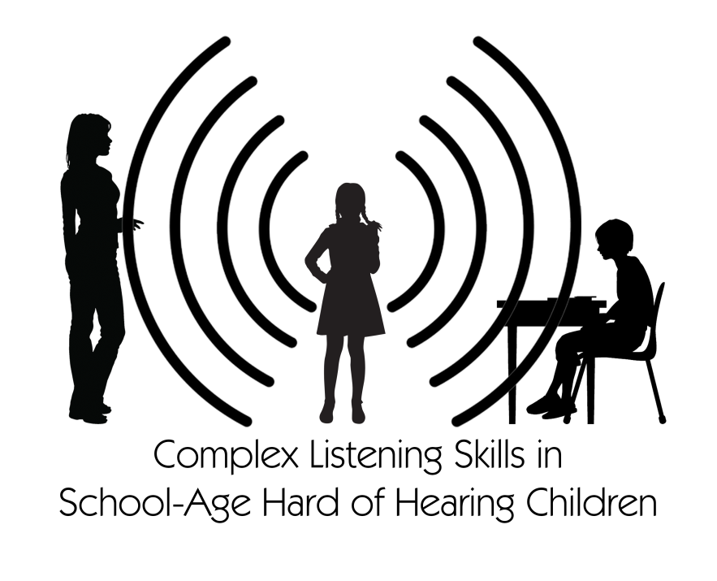
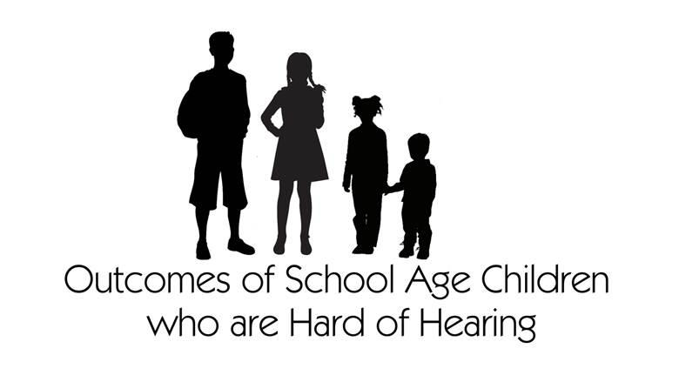
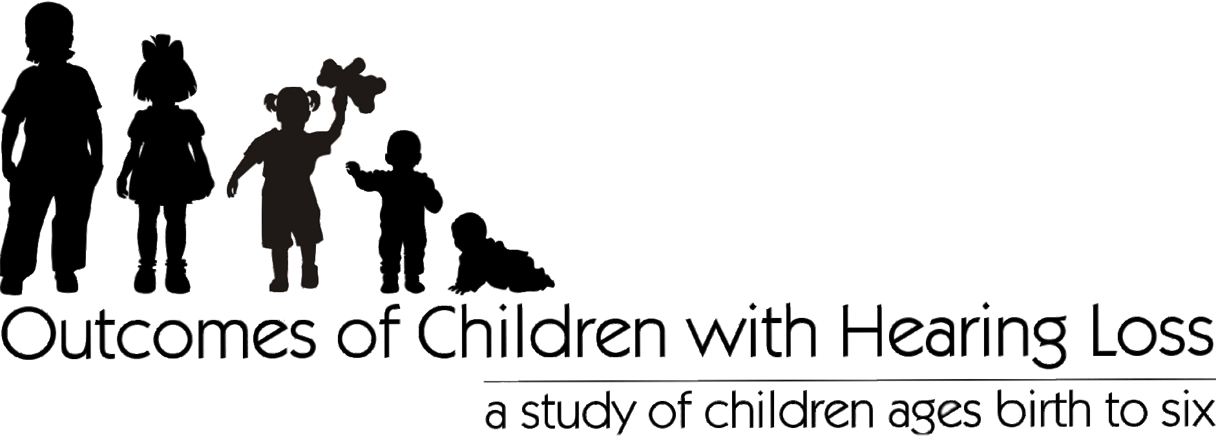
Future Directions: Outcomes in school-age children, Complex Listening, Listening Effort
Notes:
Continue to follow the OCHL cohort into elementary school. Seeing children at 1st and 3rd grades for complex listening study and 2nd and 4th grade for OSACHH.

Slide 28
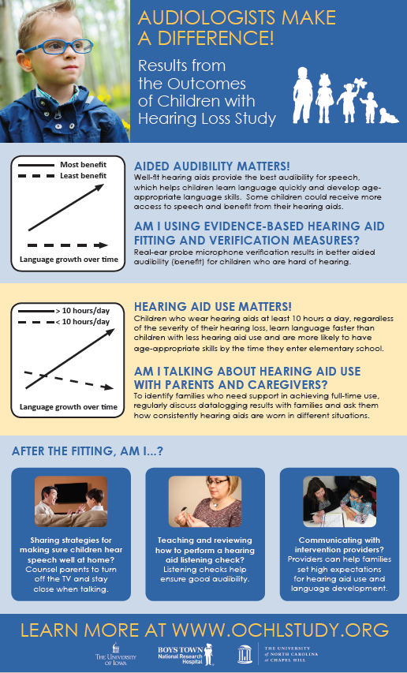
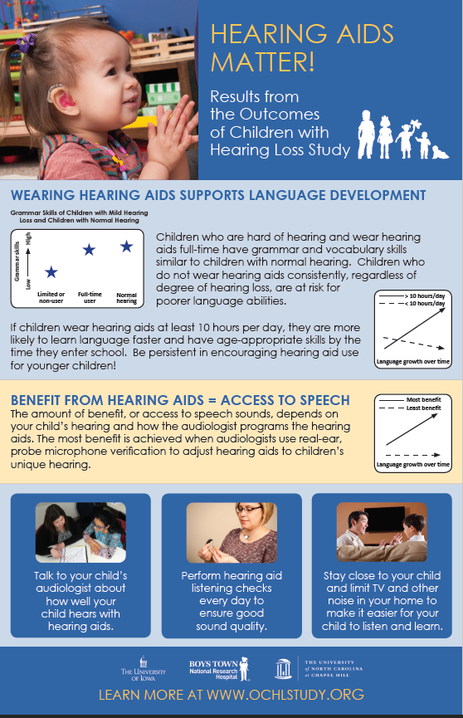

Slide 29
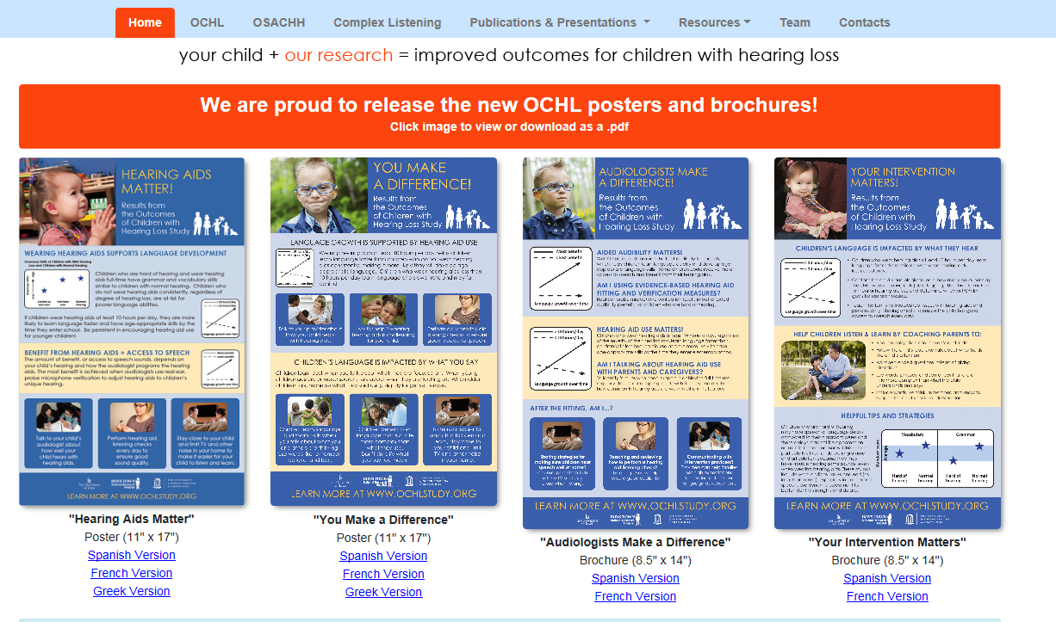
Elizabeth-walker@uiowa.edu
www.ochlstudy.org
Notes:
Thank you. Next talk will focus on preliminary findings from next generation of OCHL children as we progress into elementary school.

Slide 30
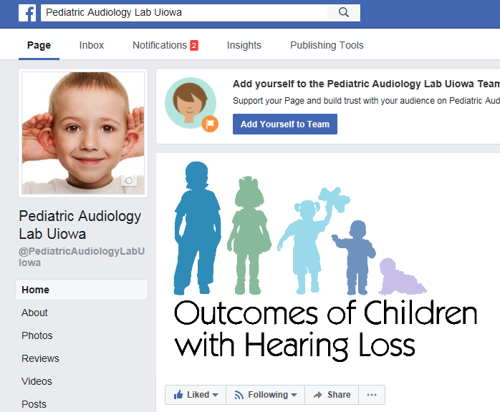
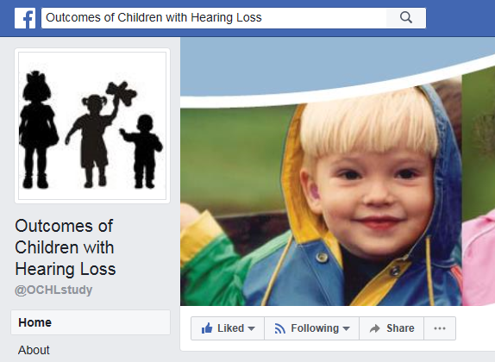
Like us on Facebook!

Slide 31
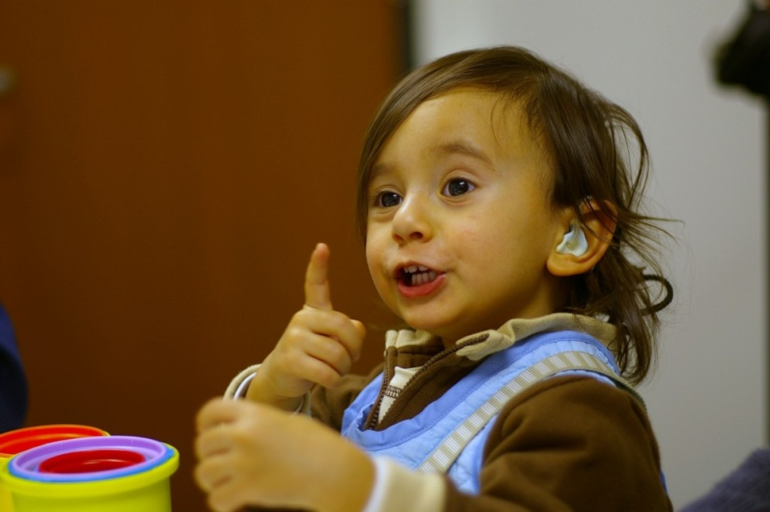
Thank you!

