Slide 1
We’ve Come a Long Way Baby! A Mother’s Thoughts and Reflections on EHDI Then and Now
Andrea Amestoy, RN/TBLV/COMS

Slide 2
INTRODUCTION
Notes:
My background…where I’m from.

Slide 3
Then…and now…
Notes:
Talk briefly of birth story, follow up, didn’t meet other families of children with HL until 4 months later.

Slide 4
Need to locate follow up then…
Notes:
Paper form from 2007. ISB now texts parents who haven’t gone in after a referral. Discuss how our process goes…referral from hospital to parents, audiology offices, etc. ISB generates a weekly list of “lost to follow up” or lost to outpatient”. I call them, speak or leave a message. If no response, I start a text thread.

Slide 5
And now…
EHDI-PALS https://www.ehdi-pals.org/

Slide 6
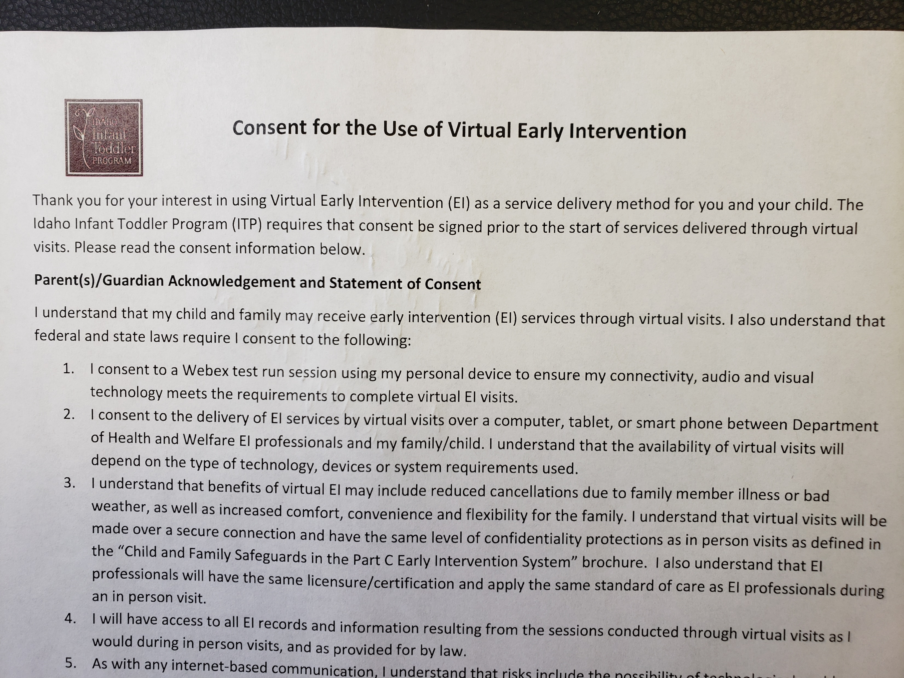
Early Intervention-Virtual!
Notes:
This really took off during the Covid pandemic. Ability to reach kids in more rural locations. Able to meet Deaf Mentors, work on ASL, virtual speech therapy visits, virtual parent support groups via zoom, Webex, teams…

Slide 7
Connection at your fingertips… immediate access to resources
https://www.isu.edu/magazine/f2017/in-this-issue/meridan-lab-helps-hatch-a-childs-potential/
https://podcasts.apple.com/us/podcast/hearing-mamas-tribe/id1609825111?i=1000552681619
https://www.stlukesonline.org/health-services/service-groups/childrens-services/parent-mentor-program/meet-our-parent-mentors/andrea
Notes:
Explosion of ways to connect with other parents. From Zoom meetings from Idaho’s support group, HATCH lab to podcasts, parent meet ups, etc. Lots of ways to find a parent to connect with. Largest health system in the state, St. Luke’s, has a parent mentor group.

Slide 9
Deaf Mentor Programs/Snap Shots
https://www.infanthearing.org/dhhadultinvolvement/states/all_states.php
https://idahotc.com/Portals/0/Resources/371/Brochure%20Deaf%20Mentor%20Mikkel%20%2010.18.2017.pdf
Notes:
How many states have a Deaf MeDeaf Mentor Programs. Check with your state to see if they have one. Great way for parents and children to meet, learn ASL and interact with adults who are D/HOH.

Slide 10
Deaf Mentor Program
Helping Idaho families create an effective bilingual environment in homes & communities.
Proven approach to help families learn ASL through everyday routines with their children.
Children with Deaf Mentors have higher linguistics skills and social emotional skill.
Families with Deaf Mentors have strong abilities to communicate understand their child

Slide 11
Snapshot Providers
Provides families of children recently diagnosed with hearing loss the opportunity to meet deaf adults and share experiences.
Deaf or Hard of Hearing adult who provides a ‘snapshot’ look into the life of a person who is deaf or hard of hearing.
May use ASL, spoken language, cued speech, signed English or a combination of these languages and modalities to communicate and interact with others in their world.
Can meet with families weekly for up to 6 weeks virtually, in the family’s home, or in the local community.

Slide 12
Hearing Aid Coverage then…
Notes:
Huge improvement!

Slide 13
And Now…

Slide 14
Hearing aids covered!

Slide 15
27 States Now Mandate Hearing Aid Coverage!
https://www.audiology.org/wp-content/uploads/2022/02/State-Hearing-Health-Insurance-Mandates-2022.pdf

Slide 16
We did it!

Slide 17
Children learning civic engagement!

Slide 18
Hearing aid technology and retention then…

Slide 19
Improvement in Hearing Aid/CI Technology now…
Directional microphones
Digital feedback cancelation to decrease whistling noise
Open fit/open canal to decrease occlusion effect of own voice when speaking
Digital processor analyzes the sound entering the microphones and classifies the listener’s sound environment. Higher technology hearing aids are now able to determine if the wearer is in a quiet situation, a noisy environment, or automobile. Classification systems can also determine if there is music present and make appropriate adjustments.
Wireless connectivity: connect to cell phones, computers and television.
Electro-acoustic stimulation, or hybrid devices, received FDA approval two years ago. This can be the solution for those who hear too well to receive a conventional cochlear implant, but who cannot use a traditional hearing aid.
Cochlear implant with no external components approved in June 2022.
Use of artificial intelligence to automatically activate the most suitable mix of settings, programs and features in new CI’s.

Slide 21
Technology Retainment
https://www.youtube.com/@andreaamestoy8528
Hearing aid pilot caps, hearing aid suspenders, cochlear implant hats, ear gear, tiles/air tags, locator apps on phone.
Notes:
Lots of ways to keep these on and find hearing aids! I used to scour bushes, the trees, the ground, used a metal detector, etc. Much easier now!

Slide 22
Accessibility on smart phones
https://www.apple.com/ca/accessibility/hearing/
https://www.android.com/accessibility/audio/
https://otter.ai/
Notes:
Android 12 comes with live transcribe and sound notifications, automatic captioning for videos and podcasts, sound amplification and hearing aid settings. Visual alerts
The LED flash on your iPhone or iPad Pro can blink when your device is locked and you receive a notification. This can be useful if you don't want to miss a notification while your device is locked. RTT calls
Real-time text (RTT) phone calls provide instant transmission of a message as you compose it. Transcripts are saved in the call history of the Phone app, and you can upgrade a regular call to RTT. FaceTime video calls
Every iOS device comes with FaceTime, so you can have video calls with other iOS users wherever they are. And FaceTime's high-quality video and fast frame rate make it ideal for communicating with sign language. Video subtitles
Some video content from the iTunes Store includes alternative audio languages or other accessibility features such as closed captions (CC) and subtitles for the deaf and hard of hearing (SDH). Headphone Accommodations
Use Headphone Accommodations to customize headphone audio settings to amplify soft sounds and adjust certain frequencies for your hearing needs. You can also use your audiogram data from the Health app to customize audio settings.

Slide 23
What Caused My Child’s Hearing Loss…then
Notes:
Worked for years trying to find cause of my son’s hearing loss. When Kylie was born, submitted blood to University of Iowa doing study on genes causing HL. Got results back 18 months later.

Slide 24
And Now…
Concurrent screening with traditional audiological measures (OAE and ABR) and genetic testing improve accuracy and prognosis of hearing loss.
https://journals.lww.com/thehearingjournal/fulltext/2022/01000/gene_therapy_for_hearing_loss_on_the_horizon.1.asp

Slide 25
Reproductive genetic carrier screening (RCS)
https://womenshealth.labcorp.com/patients/pre-pregnancy/inheritest https://www.acog.org/womens-health/faqs/carrier-screening#:~:text=What%20is%20carrier%20screening%3F,child%20with%20a%20genetic%20disorder https://www.med.unc.edu/obgyn/mfm/our-services/a-guide-to-your-carrier-testing-options/
Notes:
Parents are now more prepared in knowing they have a 25% chance of having a child who is D/HOH. Example of parents from my childbirth preparation class.

Slide 26
Literature choices then…

Slide 27
Literature with D/DB characters or D/DB authors now!
https://bookriot.com/books-with-deaf-characters/
https://www.perkins.org/books-about-deafness-or-with-deaf-characters/
https://www.slj.com/story/four-titles-by-deaf-hard-of-hearing-and-deafblind-authors-to-share-during-deaf-awareness-month

Slide 28
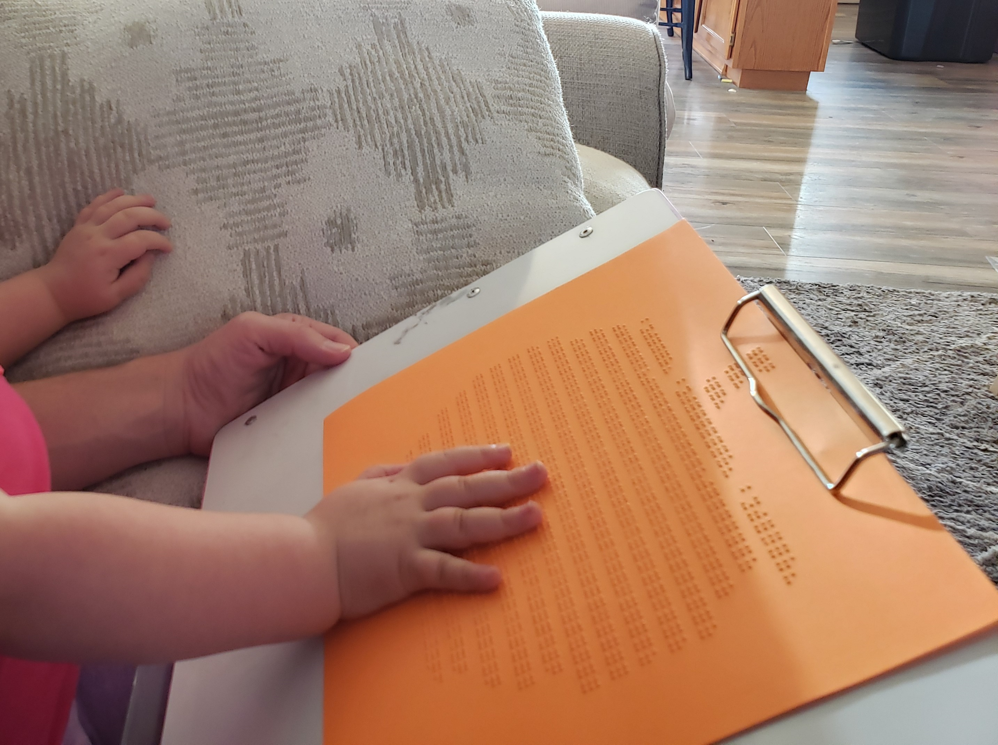
Notes:
If it were not for my children, and the recessive genes they carry…I would not be blessed and privileged to work with children who D/HOH and/or B/LV. Thank you!

Slide 29
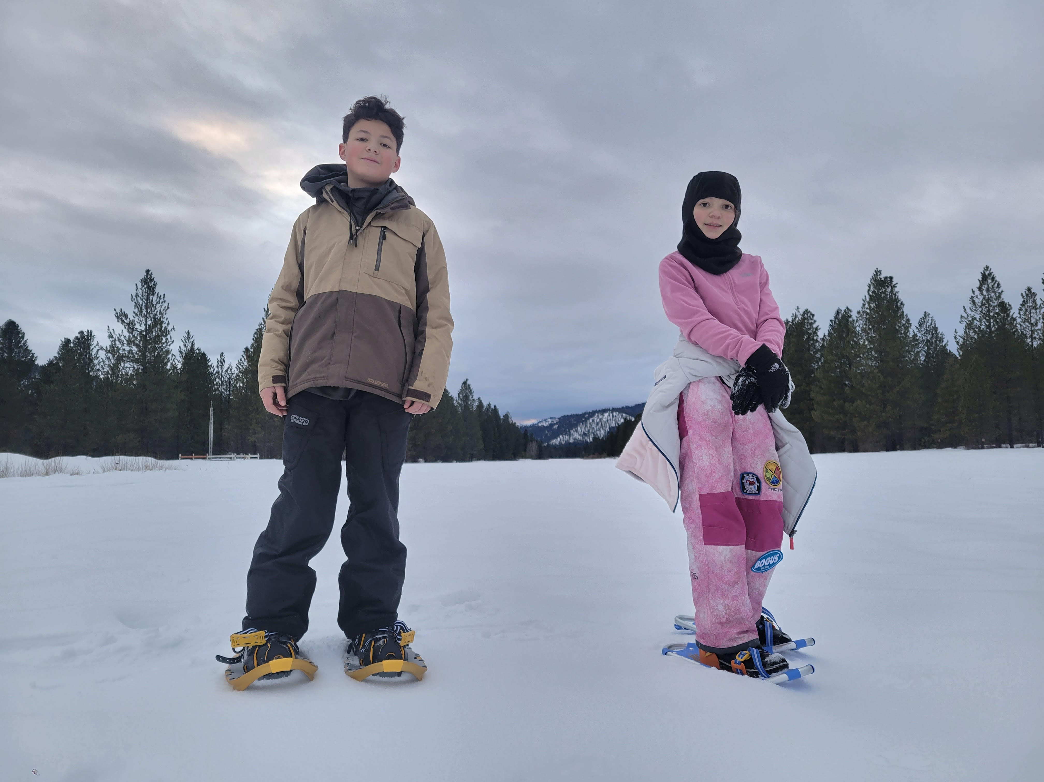
The Horizon…
Notes:
What’s on the horizon? What are you, as invested EHDI players interested in doing to push forward? To break boundaries? To see new horizons within your own EHDI Program…as a provider…as a parent…as an EI…as an SLP…as a teacher of the deaf?

