Slide 1
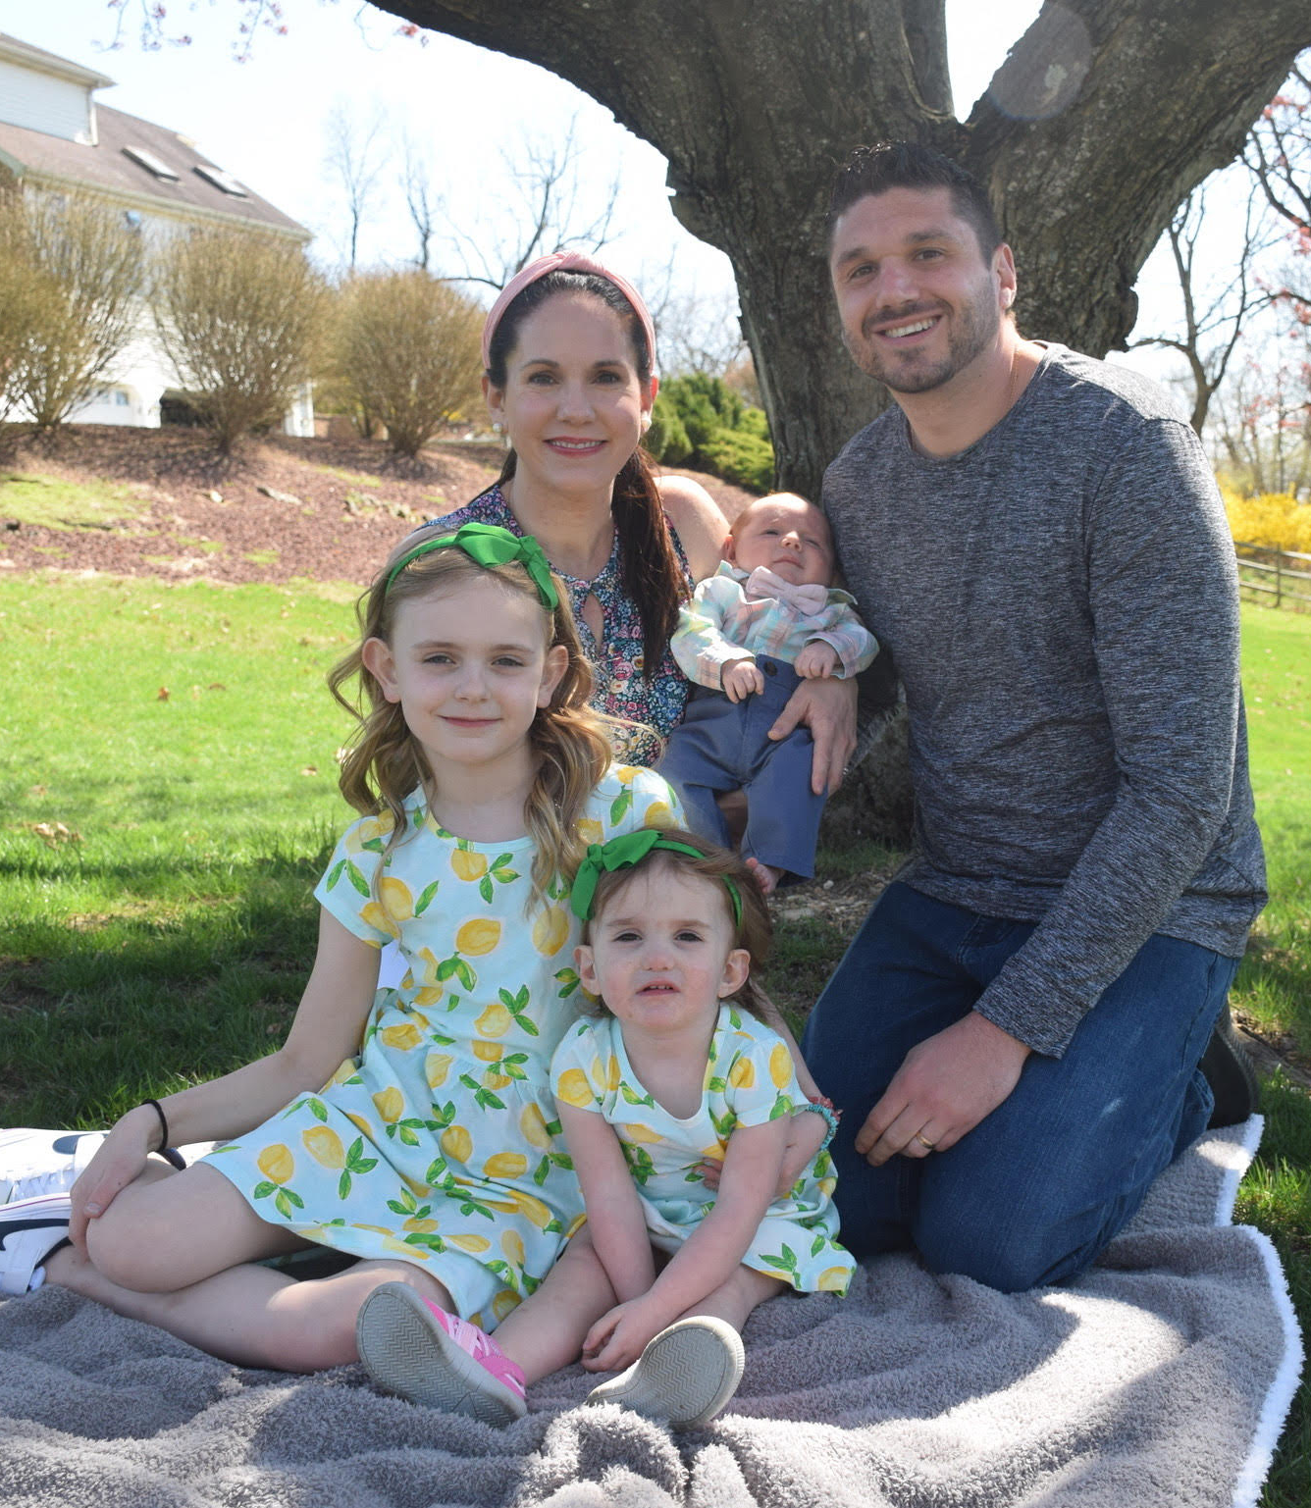
We’ve Come a Long Way: Amalia’s CHARGE syndrome journey
Notes:
Kate: a mom of 3 kids. Teagan, Amalia and Nico.
Married to my husband Tom.
Full time critical care physician assistant.
Eastern PA outside of Philadelphia
Tell you about Amalia’s story, our experience and what has helped us navigate supporting Amalia

Slide 2
Born December 2020
Notes:
Uncomplicated pregnancy. 38 week c section due to extra amniotic fluid (snow storm and peak of COVID surge)
First C section- had post partum hemorrhage with first delivery
Whisked away to the NICU from OR due to low oxygen saturation
Immediately started crying- wanted to be able to hold her and was scared about what was wrong. and didn’t hold my oldest daughter for 2 days.
A few hours of recovery- able to see her
Weaned off respiratory support but NICU attending told us facial droop, nasal and mouth asymmetry and external ear abnormalities
First time we knew that something was different with her
Couldn’t sleep that whole night because I was worried about her- she was still in NICU

Slide 3
Initial Evaluation
Facial asymmetry- MRI brain to rule out stroke
Feeding difficulties and aspiration
Need for respiratory support again
Placed a nasal feeding tube for nutrition
Low muscle tone
Heart murmur
Fluid in the kidneys
Early genetic testing
Notes:
Attempted oral feeding but had aspiration with need for respiratory support again
Given the initial physical exam findings and her aspiration and poor feeding/falling asleep, there was concern that she had a genetic condition.
Prader Willie syndrome
Started nasal feeding tube feeds
Working with speech therapy for bottle feeds

Slide 4
First Christmas
Notes:
In the hospital over the holidays, so no consults or testing was done over Christmas and NY
Sitting in the hospital with no answers and little hope of taking her home. Had planned in my mind her first Christmas at home.
Mentally, it was a dark time for me. Post partum and mourning the loss of an idea of having her home- HOPELESS

Slide 5
When everything changes…
Notes:
She had a barium swallow which showed concerns with the first part of her swallow.
Also unable to pass NGT down let nasal passage
We had concerns for an anatomical issue
Finally, Jan 2 seen by ENT who attempted scope her nose but was met with resistance.
Didn’t have a small enough scope.
But did get a CT scan of facial bones and diagnosed her with choanal atresia- that’s when everything changes
Transfer to CHOP the next day for pediatric ENT and genetics- first time we heard about the concern for CHARGE syndrome

Slide 6
Transfer to Children’s Hospital of Philadelphia (CHOP)
Notes:
2 weeks old
1.5 hours away from our home

Slide 7
CHARGE syndrome
C: coloboma or cranial nerve
H: heart defects
A: atresia of choanae
R: retardation of growth or development
G: genital/urinary abnormalities
E: ear malformation and/or hearing loss
Genetics: CHD-7 gene most common gene affected
Most frequently, de novo mutation
Notes:
Did a ton of research about CHARGE syndrome and all the features
Cleft lip or palate
Laryngomalacia- breathing concerns
Endocrine disorders
Swallowing issues
Leading cause of “deaf blindness”
Facial asymmetry and other facial features
Met with genetics and had CHD-7 gene sent

Slide 8
Hospital Days
Notes:
A lot to keep track of with more testing and consultants
(Genetics, ENT, cardiology, urology, plastic sx, speech)
Did seem more of a relief to have her at a children's hospital who was better equipped to take care of complex needs
During COVID, could not have any visitors. Her sister could not meet her. We couldn’t have the support of our parents or families/friends
Had to stay healthy to keep her healthy so even at home we were isolating.
Had to wear a mask in the NICU- want to kiss baby and let them see your face
Balance between 1.5 hr drive to Philly and home life with a 5 year old in hybrid Kindergarten
Finally felt hope of getting an answer and having a plan to go home

Slide 9
And more hospital days…
Notes:
Ear molds with plastic surgery.
NG tube, bottle feeding trials, breast milk and thickened formula
Had a second barium swallow showing frank aspiration.
The decision was made to place a G tube. Excited. I could finally take her home!!!

Slide 10
5 weeks old Her first surgery
Notes:
Finally planned to have a G tube placed for feeds given continued aspiration
Night before surgery, staying at Ronald McDonald house in Philadelphia
Got a call that she would need a sedated ear exam during OR for G tube placement due to her hearing test
Informed that she failed hearing in left ear- wasn’t actually a surprise to us
Was so laser focused on getting her home, didn’t matter what issues we would need to support her through
Her sedated exam was normal, no fluid
G tube education
Right before discharge- called that CHD 7 gene was negative
Still no diagnosis- whole exome sequencing was sent

Slide 11
Finally going home after 42 days
Notes:
This is when a whole new chaos began
Coordinating with insurances, scheduling follow ups and fighting with medical supply companies (IYKYK)
Gravity feed and eventually transitioning to a pump
LOTS of YOU TUBE videos and facebook support groups
Watching for aspiration with oral feeds
Washing all the equipment, bottles, G tube supplies and breast pump parts= full time job
All while adjusting to the normal changes with having a newborn at home
Still worried about COVID and her getting sick but also wanting to teach family of how to care for her as well. (Wouldn’t be able to go to daycare)
Follow up appointments- ABR needed to quantify her hearing loss

Slide 12
“Sleeping” ABR
Notes:
Scheduled first ABR in Philadelphia. Balancing traffic, pumping and feeding her.
3 months old at this point. More wakeful.
She only slept for 10-15 mins. She had slept the whole car ride down. Unavoidable.
G tube hooked up to her. Learning to use the pump on the go.
Can't soothe her to sleep with a bottle.
Second ABR- woke up.
Had a melt down when I got home. 3+ hours of driving for a maybe 20 minute appointment
Third ABR- woke up but felt confident we had enough information collected over the last 3
Trying to get them scheduled ASAP and driving all over Philadelphia area to different locations for first available appointments
Audiologist- moderately severe conductive hearing loss in LEFT and normal hearing in the right (FINAL diagnosis around 4 months old)

Slide 13
Pennsylvania Early Intervention Program
PT
Special Instruction-Hearing
SLP for feeding
ASL course at local community college
Eventually, added OT and special instruction for vision

Slide 14
Family Connections for Language and Learning Pennsylvania State
Anne Gaspich, Program Director
Parent Mentor
Deaf Mentor
Facebook group with resources, education and events
Virtual classes
Reading materials and articles
ASL courses and references
Introduced to American Society for Deaf Children
Notes:
Deaf Mentor- taught us early signs. Gave us resources for early language. Signed books to Amalia. Still meet with her.
Parent Mentor- sent me meeting and educational opportunities. Gave me advice about situations and experience.
So overwhelmed- her hearing loss took a back seat. So much available to me but didn’t know what to do with all the information.

Slide 15
Life with Amalia
Notes:
I went back to work full time and we had my father-in-law come take care of her at home
Her whole exome was negative for any answers as to her diagnosis
Referred for cranial helmet therapy
Getting by with addressing each medical problem but had no unifying diagnosis
Sent for CT of inner ear and referral to an ENT who specializes in the inner ear due to her conductive loss in case surgery was an option

Slide 16
CT scan of her middle ear
Absent left oval window and underdeveloped stapes
No semicircular canals bilaterally
CT findings consistent with CHARGE syndrome
Still no genetic diagnosis
Genetics were not willing to give her the diagnosis with lack of genetic confirmation
Given lack of answers, reached out to genetics at Cincinnati Children’s Hospital CHARGE center
Notes:
After meeting with Dr. Germiller and reviewing her CT results, he was confident that the findings were 2/2 CHARGE syndrome
No surgical intervention that could be done to correct her hearing loss
Balance and vestibular issues are very common in CHARGE and Amalia would have a challenge with balance and walking
Frustrated with lack of “why”, reached out to Cincinnati due to the high suspicion this was charge syndrome
Genetics recommended an epigentic testing
CHOP genetics ordered test around 1 birthday

Slide 17
Bone conduction hearing aid
Notes:
11 months old
After helmet therapy, she got her hearing aid

Slide 18
Diagnosis
Epigenetic testing confirmed CHARGE syndrome diagnosis at 13 months old
Evaluation in Cincinnati Children’s CHARGE center at 18 months old
Notes:
Great experience speaking with experts who knew the ins and outs of CHARGE
Had tests and exams that she had never had before
Comprehensive evaluation

Slide 19
Oral Eating
Notes:
Enrolled in an oral feeding through chop and followed protocol to wean off TFs for nutrition
Had developed a lot of vomiting with TFs
Still struggle with weight gain and oral input
Primary hydration through G tube and thickened liquids by mouth

Slide 20
Choanal Atresia Surgery

Slide 21
Daycare
Notes:
At 2 years old, Amalia mastered walking independently. She was eating an oral diet and we were about to have another baby.
We enrolled her into a local daycare 3 days a week
She thrives at daycare with peers. But fall safety, hearing aid education, choking risks all concerns
Lukily had her EI therapists doing her sessions at school which very much helped with the transition since they knew her so well

Slide 22
Nico Arrives

Slide 23
Attended Pennsylvania Great Start Conference July 2023
Network with other families
Amalia met other toddlers with hearing loss and wearing technology
Parent Cafe
Meet with many parent mentors from all over the state
Learn about ways to advocate for Amalia
Learned of more online resources
Parent to Parent of PA
Met our deaf mentor in-person
Paid for which makes it accessible to all families despite financial resources
Notes:
my daughter met other toddlers with hearing loss and hearing technologies
Invaluable resource to meet other families and share experiences
Sparked a fire in me to get more involved!
Which is what promoted my interest in this conference

Slide 24
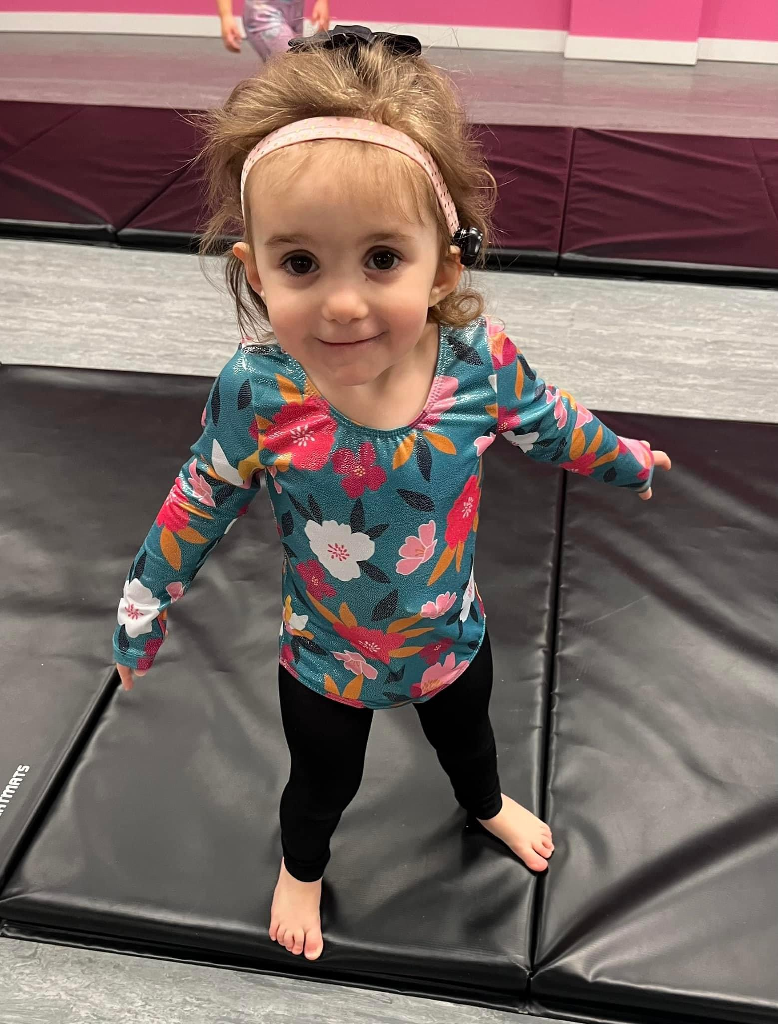
Recently…
Getting ready to transition to pre-school in fall
Learning and using more ASL and spoken language
Just entered the 3-5 year old school-based EI program
Enrolled in tumbling class
Drinking thin liquids by mouth
Notes:
Amazing outpatient therapists (SLP, OT, PT)
Daycare has been wonderful and loving with her and her needs

Slide 25
Challenges for families of deaf plus children…
Parents to medically complex children are juggling multiple diagnoses, consultants and follow ups
Hearing loss is sometimes overshadowed by other medical problems
Follow up may be delayed when parents have many appointments to attend and coordinate
Lack of access to specialized, multidisciplinary care
Many times, a hearing loss diagnosis is made later in kids with multiple other medical problems
Language or learning struggles can be attributed to other conditions rather than untreated hearing loss
Harder to gain the information from ABR when child is more wakeful, or results are considered unreliable
Families do not have health literacy
Families aren’t made aware of state programs or opportunities
Notes:
Fortunate to have a flexible work schedule, access to a car, a partner who can help support the family while I travel with Amalia
Fortunate to have medical literacy and able to understand the medical lingo
Top priority was to feed my baby so hearing concerns did initially take a back seat for our family

Slide 26
How to support families…
Educate families
Testing expectations
Importance of early detection and intervention
Importance of early access language
Communication options
Device options
Coordinate with other services
Clumping appointments together
Refer parents to support groups to gain experience and advice from other families
Make sure the child is receiving services from early intention
Be flexible- approach each child with his or her uniqueness in mind
Provide resources for both medical and educational communities
Notes:
ASL, listened and spoken language, cued speech, total communication
As children grow, they need both support from the medical community but also the educational community
These are both so difference but so complex. Sometimes have conflicting agendas.
Just when you get the hang of one program, something changes.

Slide 27
Questions?

