Slide 1
Data Dashboard Development for EHDI 1-3-6 Tracking and Follow-up
March 19, 2024
Denver, CO
Contacts: Rhode Island EHDI
Ellen Amore (ellen.amore@health.ri.gov)
Gail McDonald (gail.mcdonald.CTR@health.ri.gov)
Liza Then (liza.then@health.ri.gov )

Slide 2
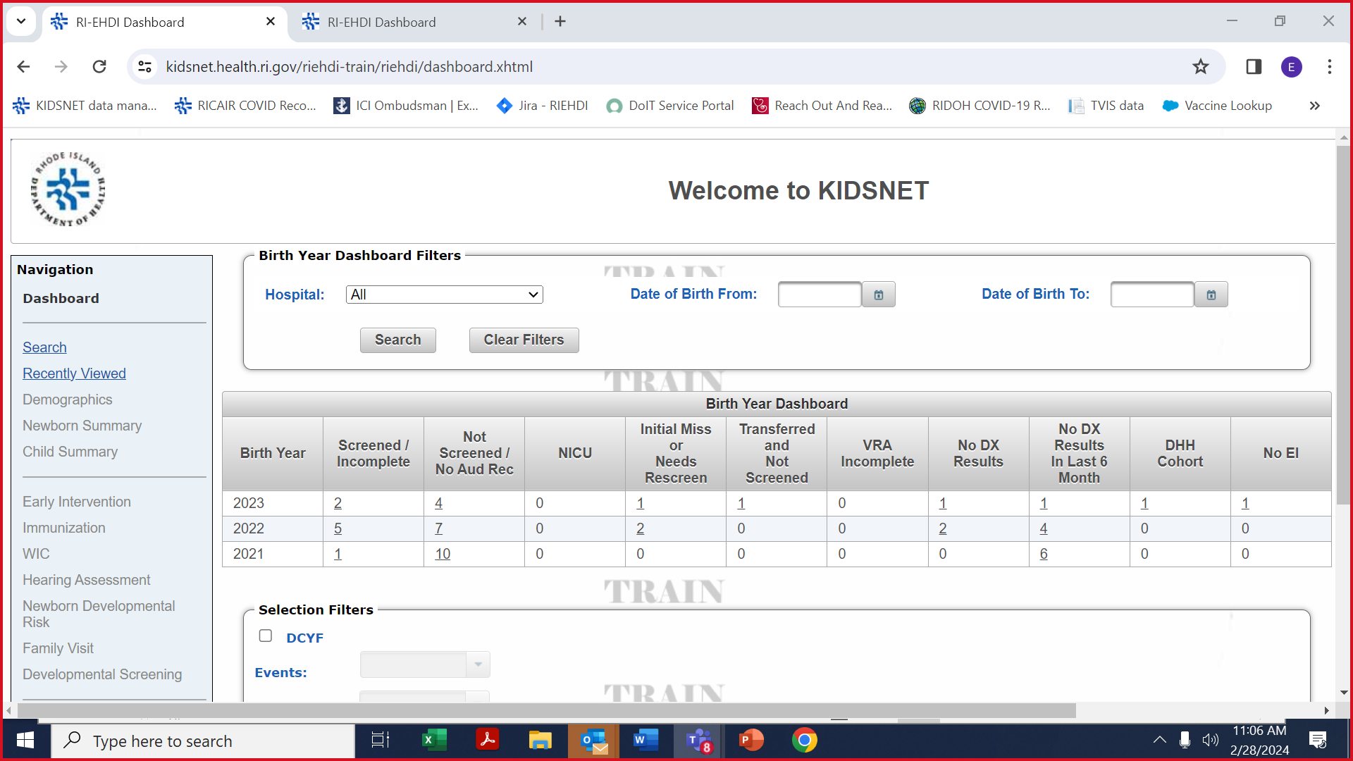
RI EHDI Dashboard – Landing Page
Notes:
EHDI staff can search or filter by hospital, date of birth, foster care, follow-up activities, and screening recommendations

Slide 3
RI EHDI Dashboard
Only babies born in Rhode Island that need follow-up appear on the dashboard
Babies move from column to column as they move along the screening, diagnosis, early intervention continuum

Slide 4
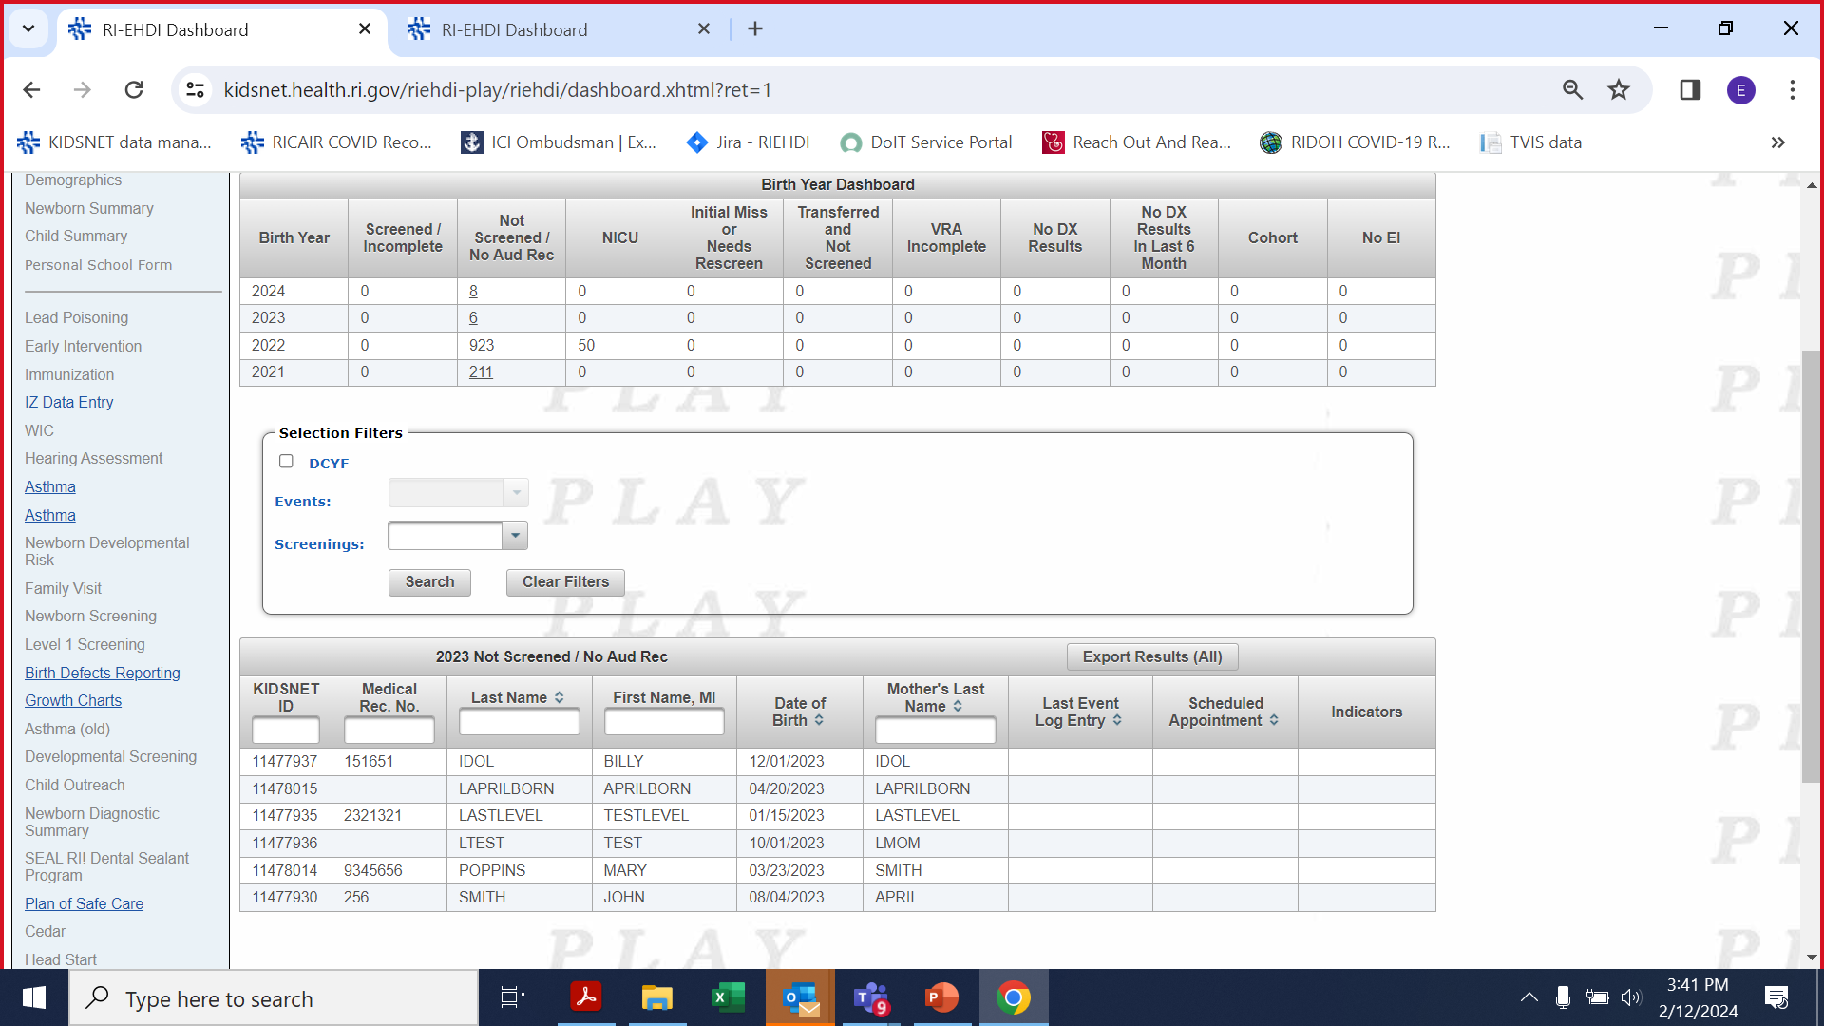
RI EHDI Dashboard
Click on number to see list of babies
Notes:
Enter KIDSNET ID, Medical record, name, or Mother’s last name to jump to an individual child

Slide 5
RI EHDI Dashboard
Click on name to go to individual record
Notes:
Summary data is a snapshot of what is needed in the 1-3-6

Slide 6
RI EHDI Dashboard
Go to Contact/Event Log tab to see follow-up communications and activities
Notes:
Can add scanned documents, scheduled appointments, referrals, etc. for record keeping – easy to see who did what for this family/baby

Slide 7
RI EHDI Dashboard
Go to Risk Factors tab to see or enter hearing loss risk factors
Go to Screening Results tab to see all screening results
Notes:
Can add scanned documents, scheduled appointments, referrals, etc. for record keeping – easy to see who did what for this family/baby

Slide 8
RI EHDI Dashboard
Go to Outcomes tab to enter reason for not completing screen, diagnostic or EI enrollment using HSFS categories
Notes:
Can add scanned documents, scheduled appointments, referrals, etc. for record keeping – easy to see who did what for this family/baby

Slide 9
EHDI-IS Reports

Slide 10
KIDSNET

Slide 11
KIDSNET – Diagnostic Audiology

Slide 12
KIDSNET – Early Intervention

Slide 13
KIDSNET – EHDI Follow-up Report

Slide 14
KIDSNET – EHDI Follow-up Report

