Slide 1
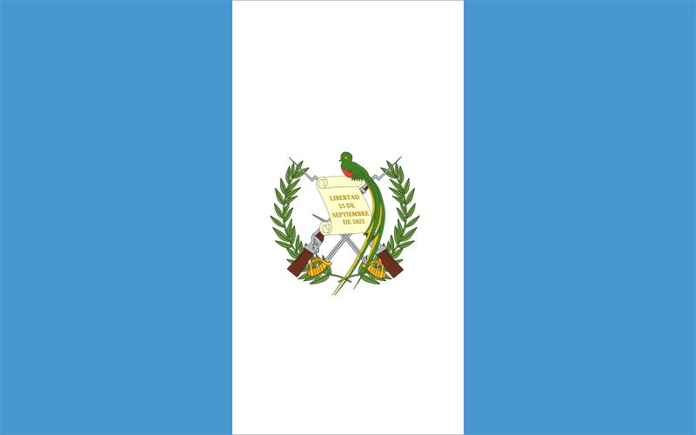
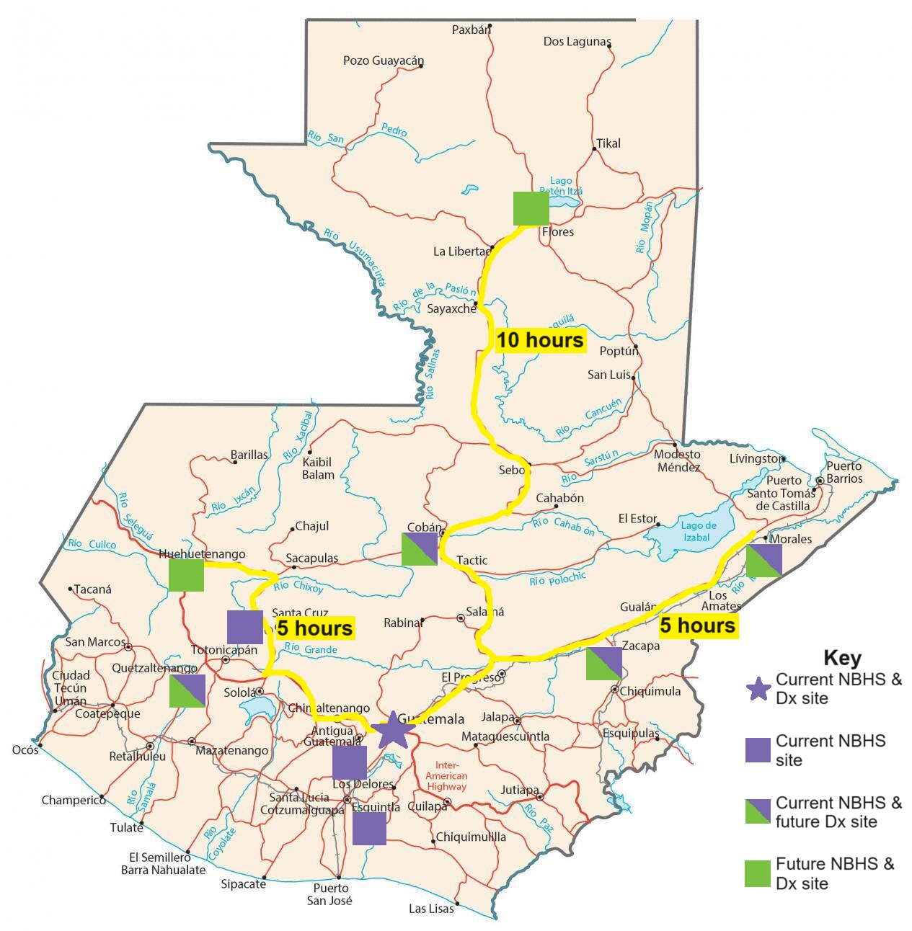
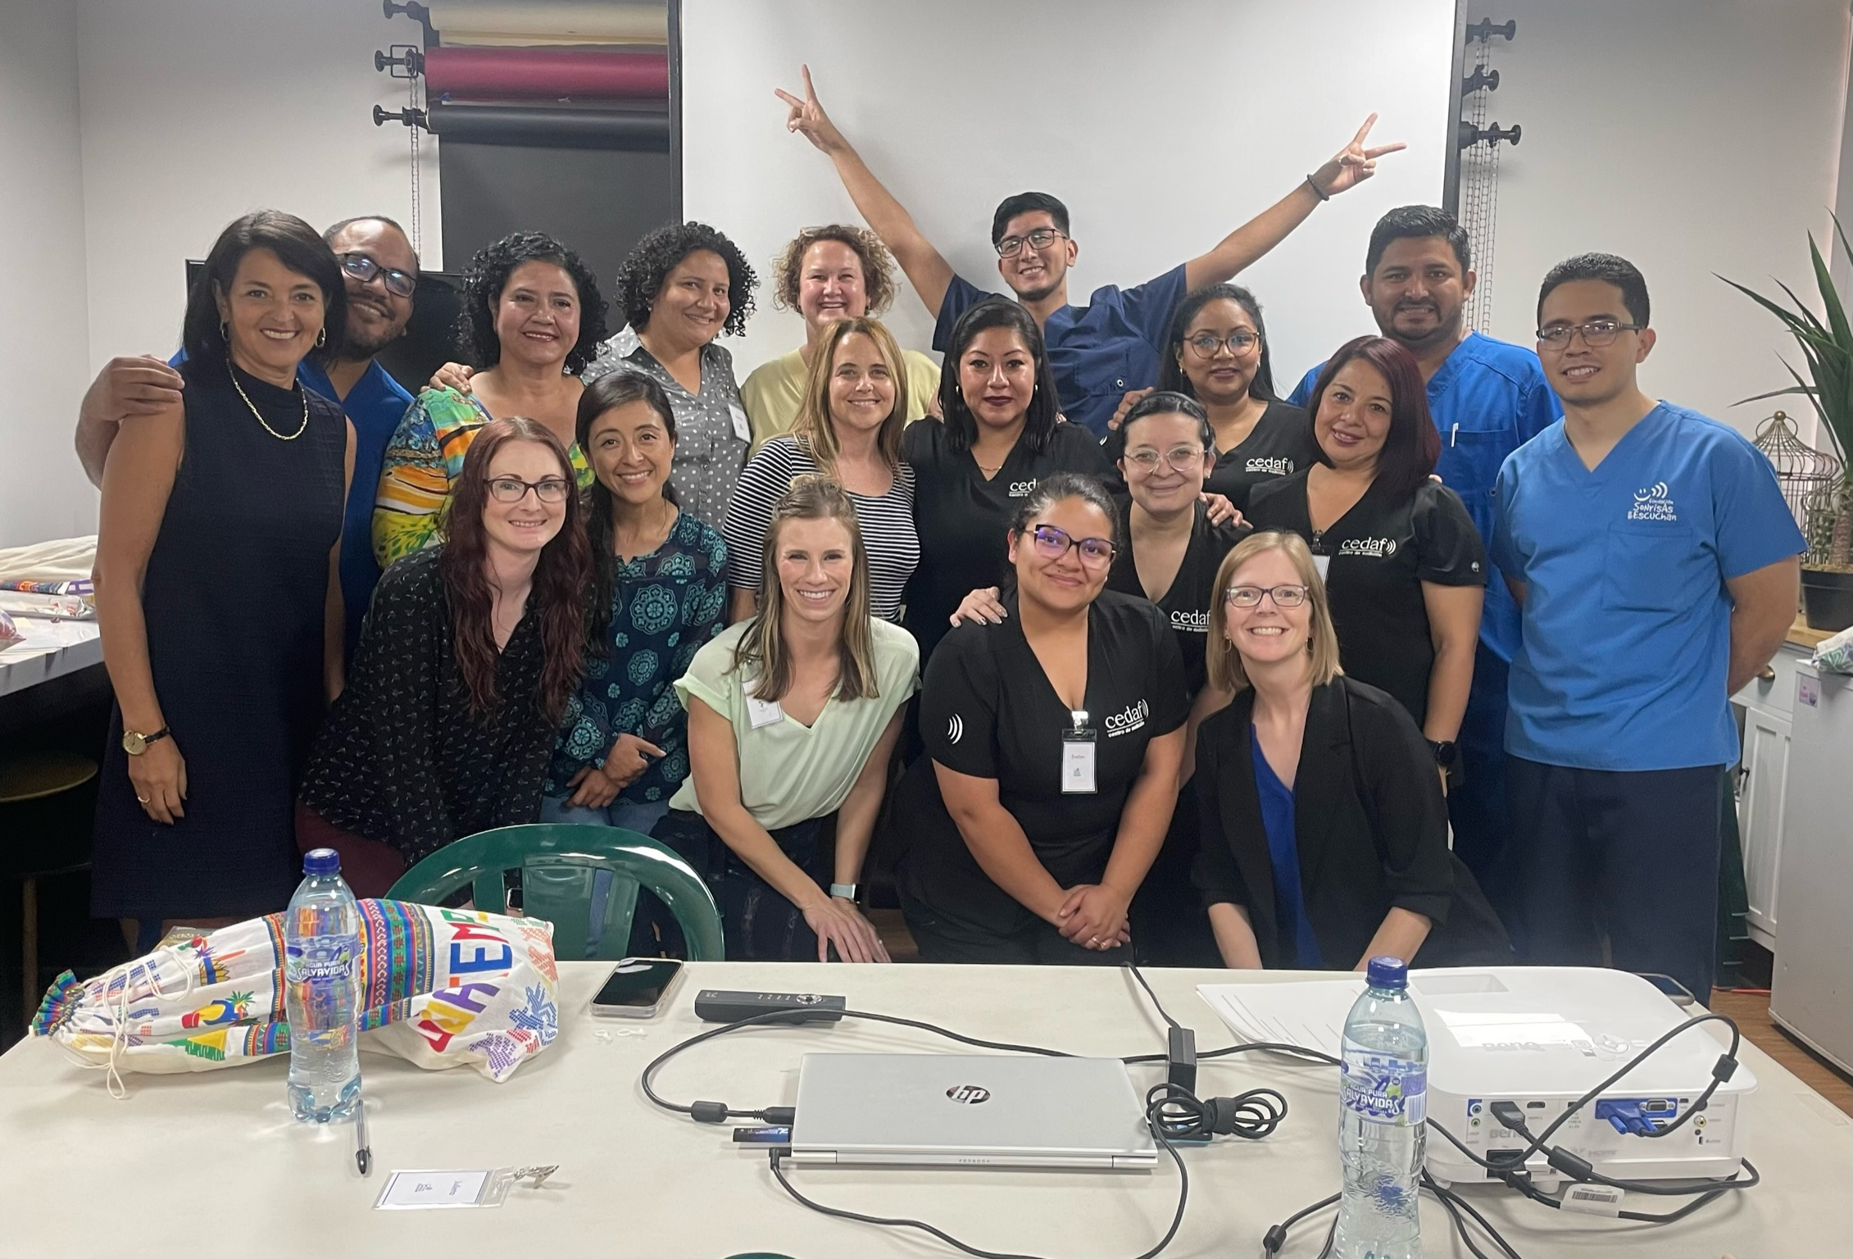
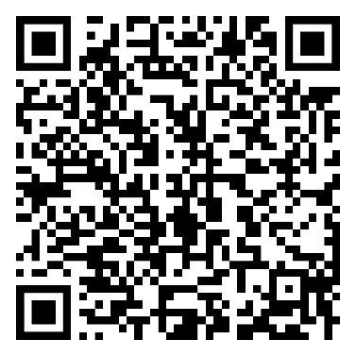
Newborn Hearing Screening & Diagnostic Services in Guatemala
Andrea Gatlin, AuD¹, Karen Hendrick, AuD¹, Patricia Castellanos, AuD², Rebecca Awad, AuD¹, Jennifer Drohosky, AuD¹, & Ericka Schicke¹, AuD 1- Children's Hospital Colorado, 2 – Sonrisas que Escuchan, Guatemala
BACKGROUND
DISCUSSION
Guatemala is a country in Central America with a population of over 17 million. There is one audiologist for the country, Dr. Patricia Castellanos, AuD, who has dedicated her life to expanding access to hearing healthcare for all ages, especially infants. The majority of audiologic services are provided in Guatemala City through her private clinic Centro de Audición and her non-profit foundation Sonrisas que Escuchan, Smiles that Listen. Additionally, she has trained 34 hearing technicians that provide audiologic services across the country.
Newborn hearing screening (NBHS) has been very limited due to lack of access to technology, supplies, and training as well as limited financial support at the national level. The goal of universal NBHS is further complicated by the country’s high birth rate and high rate of home-births (Fig. 1&2). Last year, over 350k babies were born in Guatemala and 13,490 babies were screened across 13 hospitals.¹ With the prevalence of congenital hearing loss (HL) ranging from 2 to 4 per 1000 births in Latin American countries,² this means that approximately 3 babies with HL are born every day in Guatemala. Currently, most families must travel several hours for their infant to receive a diagnostic (Dx) test following a failed NBHS. Unfortunately, this means the average age of diagnosis of HL is over three years of age.¹
Although additional ABR and OAE equipment will expand access to and facilitate more timely evaluation of infants’ and children’s hearing, it is only the beginning of the work that needs to be done. A week is of course not enough time to become proficient at ABR testing. Dr. Castellanos is continuing to provide Dx ABR training to her hearing technicians with opportunities for CHCO audiologists to provide support virtually. She has also developed competency evaluations to ensure quality testing and accurate diagnosis. In addition to more training, Dr. Castellanos and her team identified several other barriers on their journey towards universal NBHS: ongoing cost of supplies and equipment maintenance/calibrations, limited financial support from the government, limited advocacy and support from physicians, as well as stigma and cultural beliefs surrounding HL.
Figure 1: Number of births per 1000 population in Colorado and the three states with the highest rates compared to Guatemala.³⁻⁷
Figure 2: Percentage of births occurring at home in Colorado and the three states with the highest rates compared to Guatemala.^{8,9} In remote, indigenous populations of Guatemala, the home birth rate can be as high as 82%.¹⁰
Training Schedule​
Day 1: Intro to NBHS, EHDI, & Anatomy/Physiology of OAEs and ABRs​ Day 2: Building a NBHS Protocol Discussion​
Beginner Track​ | Advanced Track​
Day 2:​ OAE practice & Intro to ABR software​ | Day 2:​ ABR practice, ASSR & ANSD lectures​
Counseling Families​
Day 3:​ ABR screening practice & NBHS case studies​ | Day 3:​ Masking & bone conduction lectures, ABR practice​
Troubleshooting​
Day 4:​ Practice on each other​ | Day 4:​ Practice on each other/sedated ABRs​
Day 5:​ Observe sedated ABRs​ | Day 5:​ Sedated ABRs​
FUTURE DIRECTIONS
Each city is at a different place in their NBHS journey. Sites offering NBHS for the first time should prioritize screening babies with risk factors first. Sites expanding their NBHS program and starting a Dx program will need to work to develop systems to ensure follow-up from families. Expanding therapy services and facilitating family-to-family support are also key goals. Dr. Castellanos will continue to meet with government stakeholders to advocate for additional funding and legislation for NBHS. Continued data collection on screening, intervention, and outcomes is crucial to securing government support. For the hearing technicians receiving new equipment, building connections with their local hospitals and educating physicians and parents will be key. CHCO provided their team with Spanish resources for them to adapt to meet their needs. Finally, with the average age of HL identification being over three years of age, additional training in visual reinforcement audiometry and conditioned play audiometry may help reduce the need for sedated ABRs.
Figure 4: Map of Guatemala showing current and future locations of NBHS and Dx ABR testing. Donated equipment from CHCO will be used at the locations indicated by green symbols. Highlighted routes are travel times by car, but it should be noted that many families must travel by bus, resulting in even longer travel times.
METHODS
In June of 2023, a team of 5 audiologists from Children's Hospital Colorado (CHCO) traveled to Guatemala to donate five auditory brainstem response (ABR) and otoacoustic emissions (OAE) systems and provide training. Dr. Castellanos identified 20 hearing technicians interested in training. Seven technicians completed only OAE training. Five technicians were selected for the beginner track and eight technicians, with NBHS and Dx ABR experience, were selected for the advanced track. The week of training consisted of lectures and hands-on practice tailored for each track as well as large group discussions applicable to all experience levels (Fig. 3). The training culminated in testing pediatric patients scheduled for sedated ABRs. Figure 4 shows current and future locations of NBHS and Dx ABR testing.
Figure 3: Training schedule. Blue text represents beginner track topics only, red text represents advanced track topics only, purple text represents large group discussions (both tracks combined).
Image 1: Dr. Castellanos, CHCO audiologists, and trainees
References:

