Slide 1
It’s Not Them, It’s Us: Health Literacy in EHDI
Maternal and Child Health Bureau | National EHDI Conference | March 18, 2024

Slide 2
Presenters
MDH Office for Children and Youth with Specific Health Care Needs (OCYSHCN)
Tameka Thomas, MPH
Program Manager
Early Hearing Detection and Intervention
Noadya Legrand
Coordinator
Children and Youth with Specific Health Care Needs

Slide 3
Objectives:
Participants will be able to:
Define health literacy
Identify areas in their own work where they could assess health literacy
Apply one or more health literacy assessment tools to their outreach materials
Notes:
Last objectives: appears that we are teaching how to use tools vs. making everyone aware of what the tools are.

Slide 4
What is Health Literacy?
Several Definitions, but guidance is in accordance with “Healthy People 2030”
Originating from the Office of Disease Prevention and Health Promotion in 1979, Healthy People is a comprehensive plan of evidence based practices that identifies areas of improvement for the overall betterment of public health for individuals, organizations and communities.
Health Literacy - Healthy People 2030, Health.gov, n.d.

Slide 5
What is Health Literacy?
Healthy People 2030 categorizes Health Literacy into two subsections: Personal Health Literacy and Organizational Health Literacy.
Personal Health Literacy: is the degree to which individuals have the ability to find, understand, and use information and services to inform health-related decisions and actions for themselves and others.
Organizational Health Literacy: is the degree to which organizations equitably enable individuals to find, understand, and use information and services to inform health-related decisions and actions for themselves and others.
(Health Literacy - Healthy People 2030 | Health.gov, n.d.)
Notes:
Our focus and framing is I would make the "step you need" graphic - a linear path. Also, need to write out Dx, etc

Slide 6
Health Literacy in the U.S., 2022
88%
Total % of adults living in the US that have health literacy inadequate to navigate the
healthcare system and promote their well-being
Below Intermediate Proficiency
55%
22%
Basic Proficiency
14%
Below Basic Proficiency
12 %
Proficient Health Literacy
https://milkeninstitute.org/sites/default/files/2022-05/Health_Literacy_United_States_Final_Report.pdf

Slide 7
EHDI Accountability
“Public health and social service organizations are responsible for promoting health literacy and provide equitably accessed services and information.”
-Trezona et al., 2017
Notes:
Improving systems of care also increases capacity building

Slide 8
Why It’s Important:
Health Literacy Health Equity
1990: Americans with Disabilities Act (A.D.A) is enacted
2017: EHDI law reauthorizes Health Resources and Services Administration (HRSA) funding for continuous improvements of EHDI programs
“Health Literacy” coined by Scott Simonds, published in “Health Literacy as a Social Policy”
Congress authorizes EHDI programs
Healthy People 2010 states Health Communication as one of 28 focus areas
2023: National Institute of Health (NIH) designates people with disabilities as population with health disparities
First WHO Definition
1978
2000
2024
1974
1998
2010
The Declaration of Alma-Ata, international meeting of the World Health Organization (WHO) officials marking major milestone for health policy; first step of going beyond the individual to examine health equity
WHO Definition Revised
Present Day Definition
1975: Individuals with Disabilities Education Act. (I.D.E.A) enacted.)
2011:New Regulations for Part C of I.D.E.A include State responsibility to properly inform and be accessible to families.
2004: Individuals with Disabilities Education Act. (I.D.E.A) reauthorized; expanded provisions and protections.
Notes:
1974: First definition/term of Health Literacy ( 50 years inthe making)
1975: health literacy laid the groundwork for futher conversations around equity in general. a pivotal act with the emergence of health literacy, how this intertwines with this act that spotlights
This meeting was an important step in public health where the focus shifted from the individual. Another good step in health equity since “health literacy was coined>
1990: Americans with Di another major milestone in health equity
First WHO Definition- was the first time using the definition for Health literacy in HEALTH PEOPLE 2020
2000: health equity and health literacy linked in the authorization of EHDI programs
2004: IDEA act reauthorized highlighting and reaffirming that this is important to address needs of those who are marginalized
2010: Healthy People 2010: shift from just definition to being one of the 28 focus areas in HEALTHY People 2010
2011: This included state responsibility to inform and involve families in the process and be accessible this lends itself to health literate materials.
2017. EHDI law prompts continuous improvement affirming work thus far and need for continued efforts
2023: National Institute of Health (NIH) designates people with disabilities as population with health disparities - new circle of influence revilving around research including people with disabilities!
2024: updated definition to focus on individuals/

Slide 9
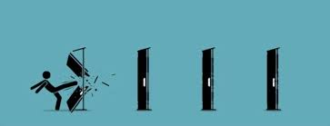
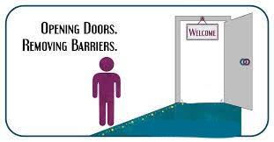
Why It’s Important
VS
Notes:
Individuals have become accustomed to having to scale their own obstacles when it should be the systems in place opening the door for them

Slide 10
Health Literacy Intersectionality Study
More Likely to be publicly insured
More Likely to have lower family income
Lower Health Literacy
More Likely to be unemployed
More Likely to be less educated
Blanchfield, Feldman, Dunbar, & Gardner, 2001
Notes:
Lower health literacy in Deaf populations is likely driven by a host of factors. A study evaluating individuals with severe and profound hearing loss from multiple national datasets demonstrated that individuals with hearing loss were significantly more likely to be publicly insured, unemployed, less educated and have lower family incomes (Blanchfield, Feldman, Dunbar, & Gardner, 2001). According to the IOM’s Health Literacy: A Prescription to End Confusion, each of these factors are independently associated with inadequate health literacy (Institute of Medicine (IOM), 2011). An additional contributing factor is information marginalization, which is suggested by worse cardiovascular health knowledge among the Deaf compared to the hearing participants in this study.
Assessing Health Literacy in Deaf American Sign Language Users- study that looked at A total of 405 participants (166 Deaf and 239 hearing) that were enrolled in the study. The Newest Vital Sign was adapted, translated, and developed into an ASL version of the NVS (ASL-NVS). The new ASL-NVS, available on a self-administered computer platform, demonstrated good correlation with reading literacy.
Forty-eight percent of Deaf participants had inadequate health literacy,
Deaf individuals were 6.9 times more likely than hearing participants to have inadequate health literacy.
Deaf American Sign Language (ASL) users struggle with a variety of communication and language barriers that reduce this group’s opportunities to benefit from mass media, healthcare messages and health care communication. This likely results in a lower general health knowledge
along with existing health disparities
in the Deaf population. Deaf ASL users rely on a visual language that does not have a written form. These individuals may lack proficiency in written English (Allen, 1986; Traxler, 2000), which when coupled with social marginalization, places them at potential risk for inadequate health literacy. Health literacy, as defined by the Institute of Medicine, is “the degree to which individuals have the capacity to obtain, process, and understand basic health information and services needed to make appropriate health decisions.” (Nielsen-Bohlman, Panzer, & Kindig, 2004). The lack of a validated and accessible health literacy measure in ASL prevents a reliable assessment of health literacy and the development of potential interventions to address gaps in this particularly high-risk population.
Deaf ASL users, like other language minority groups, lack a reliable health literacy instrument (McKee & Paasche-Orlow, 2012). Despite approximately 376 languages being used in the United States, there are very few known health literacy measures available in languages other than Spanish and English (McKee & Paasche-Orlow, 2012). This paper describes the process of adapting, translating, and validating a new computer-based health literacy instrument into ASL and reports the prevalence of inadequate health literacy in Deaf ASL users when compared to their hearing English-speaking peers.
Existing health literacy assessment instruments are not suited for Deaf ASL users due to their reliance on pronunciation (e.g., Rapid Estimate of Adult Literacy in Medicine) (Agency for Health Care Research and Quality (AHRQ), 2014) and reading comprehension (e.g., Test of Functional Health Literacy in Adults [TOHFLA]) (Parker, Baker, Williams, & Nurss, 1995). Neither phonetics nor reading of print are aspects of fluency in visual languages. As a starting point in developing a health literacy tool for ASL, we chose to adapt the Newest Vital Sign (NVS) because this instrument is not inexorably linked to phenomena of written languages and could be translated, adapted, and validated into ASL. The NVS assesses health literacy based on a person’s ability to answer 6 questions about a nutrition label and it is an optimal health literacy measurement instrument for the assessing health literacy in health care settings
The prevalence of Deaf ASL users with inadequate health literacy is substantial, warranting further interventions and research.
Communication and language barriers isolate Deaf American Sign Language (ASL) users from mass media, healthcare messages, and health care communication, which when coupled with social marginalization, places them at a high risk for inadequate health literacy.

Slide 11
Why is it important?
Adults with lower health literacy are more likely to return incomplete medical forms/assessment tools, miss appointments with health providers, and neglect follow-ups to required medical procedures.(Lopez et al., 2022)
Low caregiver literacy is common and associated with poor preventive care behaviors and poor child health outcomes (Sanders, et al., 2009)
There is a clear link between parental health literacy, health behaviour and health outcomes for children with chronic disease. (Zaidman et al. 2023)

Slide 12
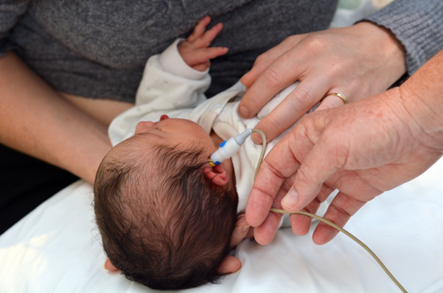
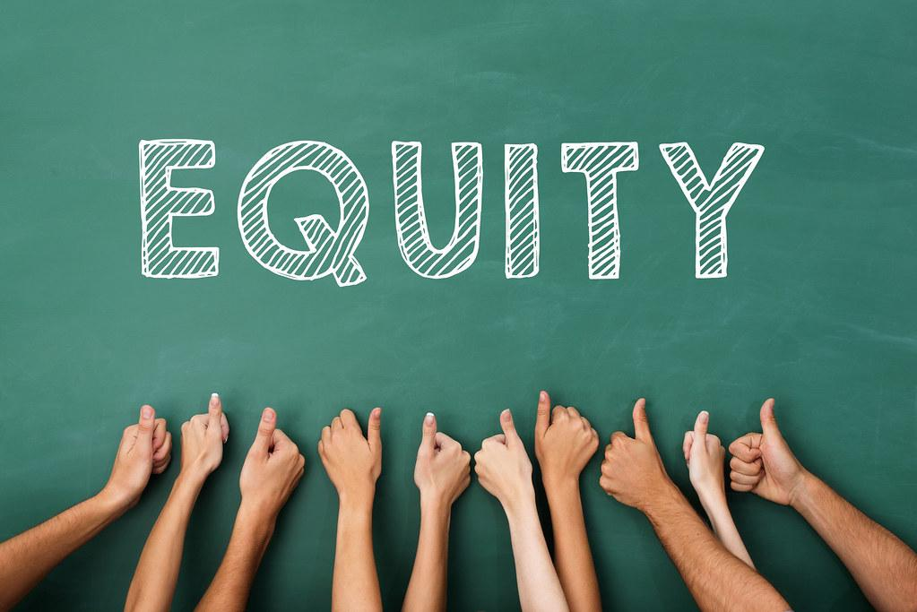
Health Literacy and EHDI
Notes:
Highlighting

Slide 13
Materials Assessed
Maryland EHDI Website
MD EHDI Resources, including:
Developmental Milestones
Letters to Parents
Helpful Hints for Parents

Slide 14
Areas of difficulty
Original MD EHDI Website:
Not easily accessible (difficult to find the website)
Hard to navigate website to retrieve information
Minimal visuals
Developmental Milestones Handout
Wordy language
Needed main message
Limited language offerings
Notes:
NOADYA Start

Slide 15
Areas of difficulty
Helpful Hints Handout
Hard to find on the website
Only offered in English
Communication unclear
Letters to Parents Handout
Limited language offerings : English and Spanish
Lack of a focus audience
ALL had HIGH reading levels

Slide 16
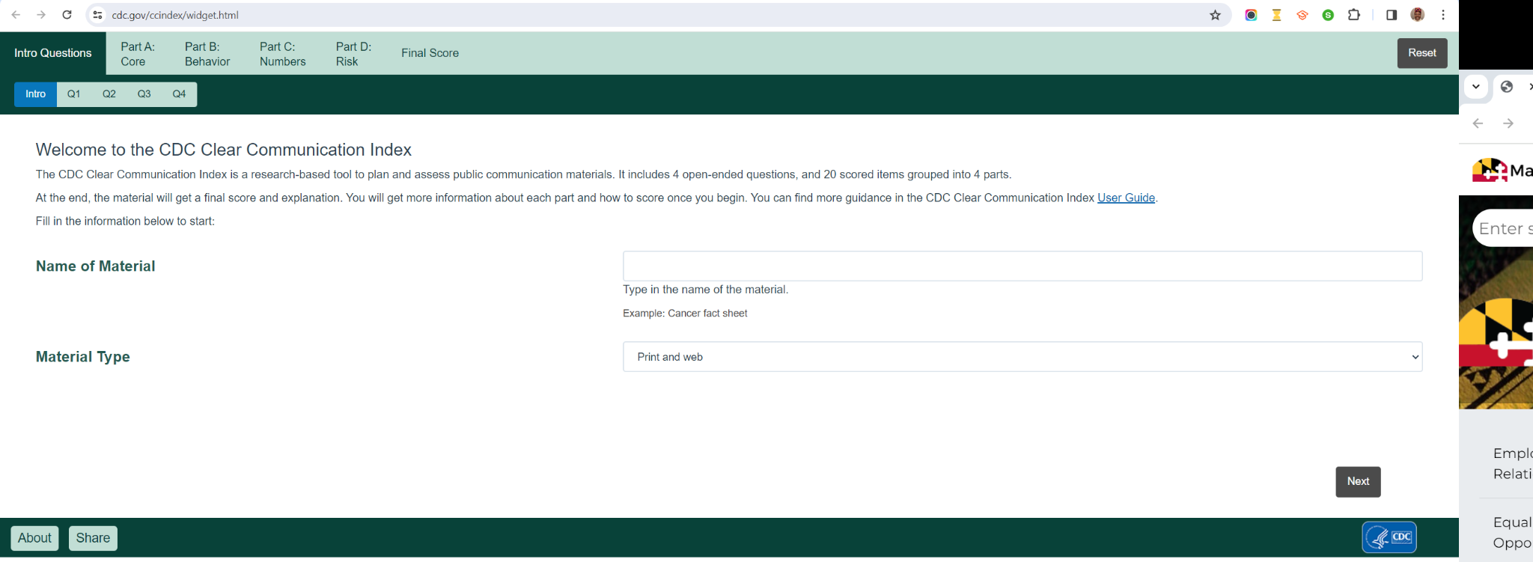
Assessment Tool: CDCCCI
CDCCCI: Center for Disease Control Clear Communication Index
Tool used to create and evaluate communication material using research pulled from scientific literature.
https://www.cdc.gov/ccindex/widget.html

Slide 17
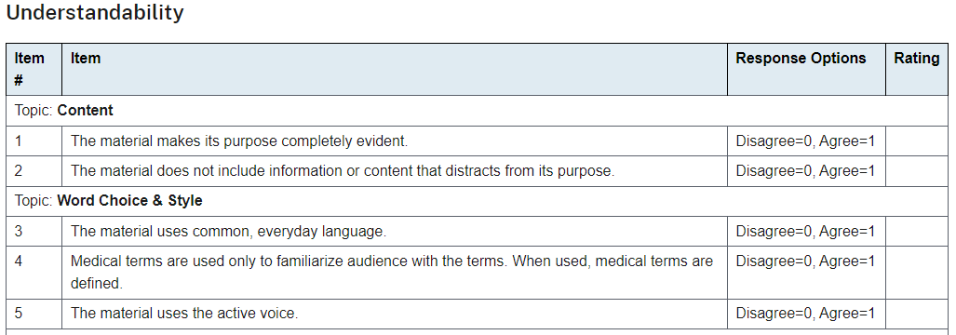
Assessment Tool: PEMAT(Understandability)
PEMAT: Patient Education Materials Assessment Tool
A guide designed to determine how well and if patients will understand and act on health information materials. Two types and two sections: understandability and actionability
P: Print/Downloadable materials
A/V: audio/visual materials
https://www.ahrq.gov/health-literacy/patient-education/pemat-p.html

Slide 18
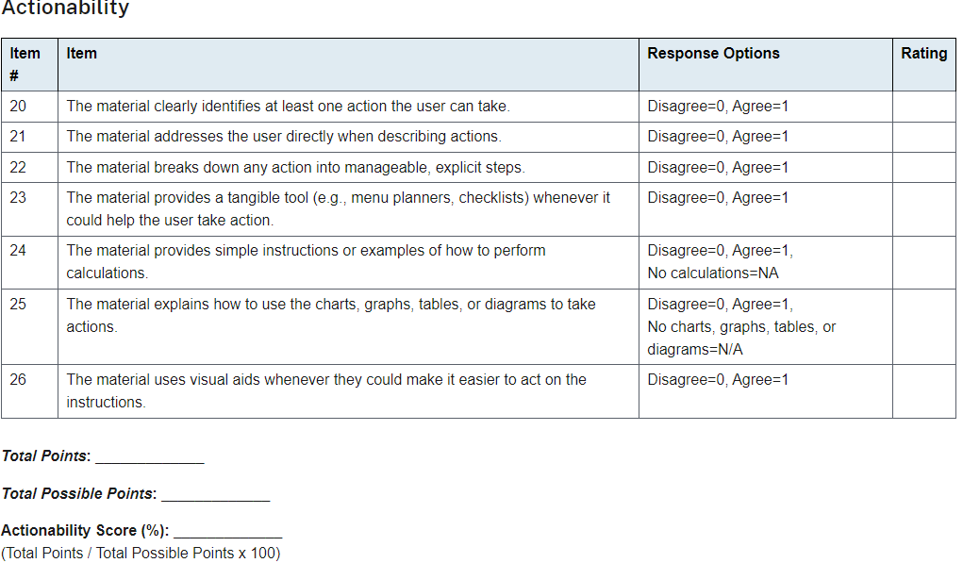
Assessment Tool: PEMAT (Actionability)
PEMAT: Patient Education Materials Assessment Tool
A guide designed to determine how well and if patients will understand and act on health information materials. Two types and two sections: understandability and actionability
P: Print/Downloadable materials
A/V: audio/visual materials
https://www.ahrq.gov/health-literacy/patient-education/pemat-p.html

Slide 19
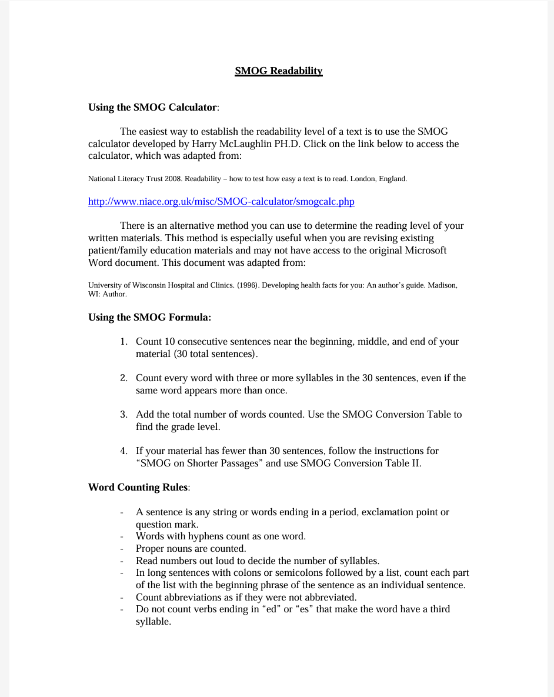
Assessment Tool: SMOG
SMOG: Simple Measure of Gobbledygook
Formula used to determine reading levels of printed/ written materials
chrome-extension://efaidnbmnnnibpcajpcglclefindmkaj/https://www.aspiruslibrary.org/literacy/SMOG%20 Readability%20Formula.pdf

Slide 20
MDH Benchmarks
Tool | Score Goal:
CDCCCI: | 90% or higher This level indicates message presented to audience is clear
PEMAT: | 90% in both understandability and actionability. Higher Score in either understandability and actionability indicates higher chances of comprehension. Ex. 90% in understandability means the document is likely to be more clear than an document scored at 60%.
SMOG: | 4th-6th grade reading level Scores indicate reading/age level required to comprehend the document. The lower the reading level, the higher number of people able to read it.

Slide 21
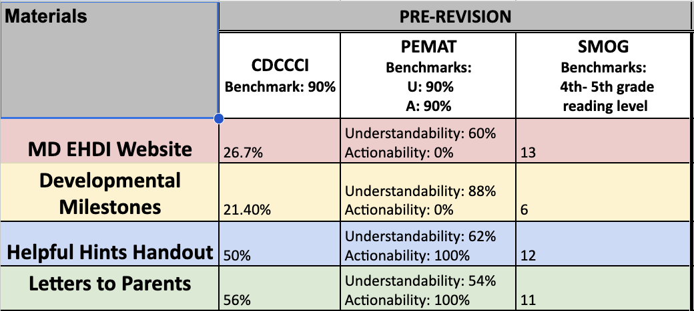
Baseline Assessment Scores

Slide 22
What was done to improve
Revised materials internally with OCYSHCN.
Revised materials with Dr. Lindsay Rosenfeld, and graduate students.
Edited materials went through several revisions by OCYSHCN.
Finalized materials were re-assessed using Health Literacy Tools for a second time.

Slide 23
Assessment Scores

Slide 24
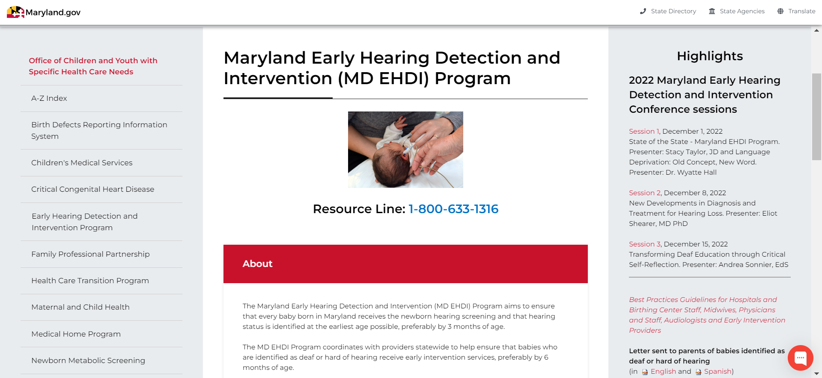
MD EHDI Website (Current)
Remove the sideline menus to create more space
Options for different audiences types
Expand space to enlarge the picture
Define “Detection” and “Intervention” . Add numbers (stats, risk,etc.). Emphasize “call to action” language
Notes:
Best overall designs of websites shared similar characteristics (no particular order):
Large Heading Font
Eye-catching color
Interactive tools
Readily available links to download
Offering translated materials
Data graphics: flowcharts, bar graphs, etc.
Relevant images and videos
Easy to read/minimal complex words
Catered to user-friendliness
Empathetic language

Slide 25
What Did We Learn?
Team Effort
Cultural Humility
Continuous Process
Notes:
Revisions are needed by multiple people. Cliche: two heads are better than one
Produced self-awareness of what our own realities vs perceived realities are and how we use that to interact with our environment. What does not affect us will go unnoticed.
Being cognizant of health literacy is a perpetual process. The work is ongoing and pushes us to always strive for better.

Slide 26
Special Thanks
Special thanks to Lindsay Rosenfeld, ScD, ScM, Brandeis University, Heller School for Social Policy & Management, Institute for Child, Youth, & Family Policy; Harvard T.H. Chan School of Public Health
Contact: lrosenfeld@hsph.harvard.edu

Slide 27
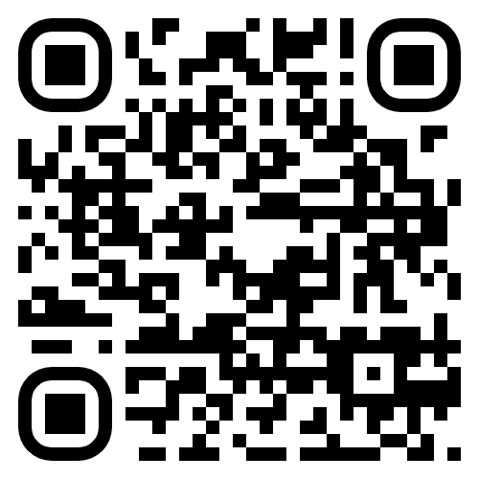
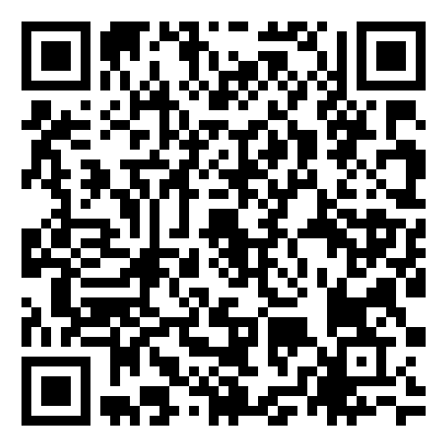
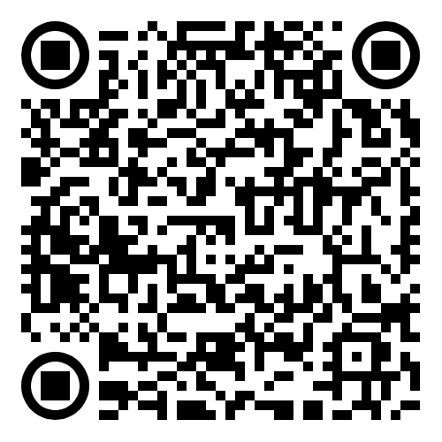
QR Codes for Tools
CDCCCI
PEMAT
SMOG

Slide 28
Works Cited
Declaration of Alma-Ata. (n.d.). https://www.who.int/teams/social-determinants-of-health/declaration-of-alma-ata
DeWalt, D. A., & Hink, A. (2009). Health Literacy and Child Health Outcomes: A systematic review of the literature. Pediatrics, 124(Supplement_3). https://doi.org/10.1542/peds.2009-1162b
Early Hearing Detection and Intervention Act (EHDI) - Hearing Loss Association of America. (2021, August 18). Hearing Loss Association of America. https://www.hearingloss.org/programs-events/advocacy/know-your-rights-archived/early-hearing-detection-intervention-act-ehdi/#:~:text=Congress%20first%20authorized%20the%20EHDI,them%20to%20early%20intervention%20services.
Healthy People - HP2010 - Focus areas. (n.d.). https://www.cdc.gov/nchs/healthy_people/hp2010/hp2010_focus_areas.htm
Healthy People - HP2020 - Topic Areas. (n.d.). https://www.cdc.gov/nchs/healthy_people/hp2020/hp2020_topic_areas.htm
Health Literacy in healthy people 2030. Health Literacy in Healthy People 2030 - Healthy People 2030. (n.d.). https://health.gov/healthypeople/priority-areas/health-literacy-healthy-people-2030
Health literacy in the United States: Enhancing assessments and reducing disparities | Milken Institute. (2022, May 17). Milken Institute. https://milkeninstitute.org/report/health-literacy-us-assessments-disparities
Impact of health literacy of parents on the health outcomes of children with chronic disease: A systematic review. (2019). Journal of Paediatrics and Child Health, 55(S2), 14–14. https://doi.org/10.1111/jpc.14467_5

Slide 29
Works Cited (cont’d)
Individuals with Disabilities Education Act. (2024, February 16). A history of the Individuals With Disabilities Education Act. Individuals With Disabilities Education Act. https://sites.ed.gov/idea/IDEA-History
Individuals with Disabilities Education Act (IDEA) Services | CDC. (2018, March 9). Centers for Disease Control and Prevention. https://www.cdc.gov/ncbddd/cp/treatment.html#:~:text=Part%20C%20of%20IDEA%20deals,be%20eligible%20for%20IDEA%20services.
Lopez, C., Kim, B., & Sacks, K. (2022). Health Literacy in the United States: Enhancing assessments and reducing disparities. SSRN Electronic Journal. https://doi.org/10.2139/ssrn.4182046
McKee, M., Paasche‐Orlow, M. K., Winters, P., Fiscella, K., Zazove, P., Sen, A., & Pearson, T. A. (2015). Assessing health literacy in deaf American sign language users. Journal of Health Communication, 20(sup2), 92–100. https://doi.org/10.1080/10810730.2015.1066468
NIH designates people with disabilities as a population with health. (2023, September 26). National Institutes of Health (NIH). https://www.nih.gov/news-events/news-releases/nih-designates-people-disabilities-population-health-disparities
New law to strengthen early hearing screening program for infants and children. (2017, October 23). NIDCD. https://www.nidcd.nih.gov/news/2017/new-law-early-hearing-screening-infants-and-children
Piao, Z., Lee, H., Mun, Y., Lee, H., & Han, E. (2023). Exploring the health literacy status of people with hearing impairment: A systematic review. Archives of Public Health, 81(1). https://doi.org/10.1186/s13690-023-01216-x
Simonds, S. (1974). Health education as social policy. https://www.semanticscholar.org/paper/Health-Education-as-Social-Policy-Simonds/e22b29742e85089b4308e57a953937a747434f24

Slide 30
Questions or Comments?

