Slide 1
Elevating Family Voice: Bridging the Transition from Early Intervention to Preschool
Presenter Information:
Donna Carpenter, KY DeafBlind Project
Danna Conn, TN DeafBlind Project
Emma Fricke, National Center on Deafblindness
Robert Hill, SC DeafBlind Project

Slide 2
Introductions
Notes:
Picture collage here - use audio description prep for Amanda’s story to take notes

Slide 3
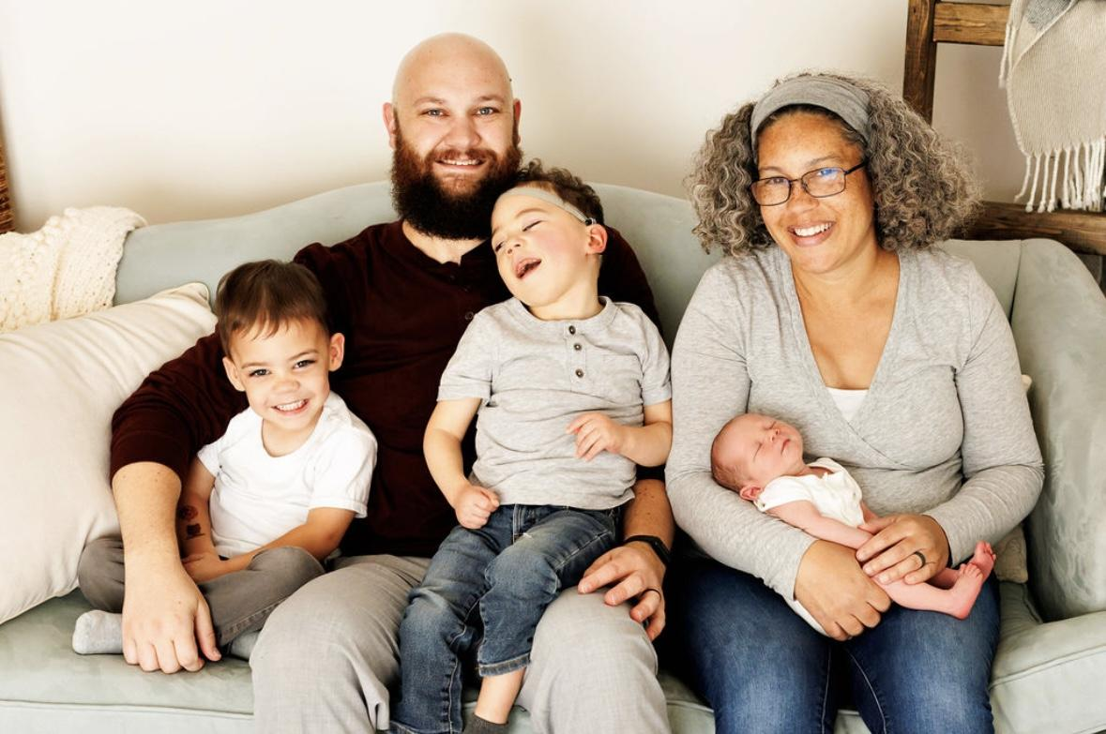
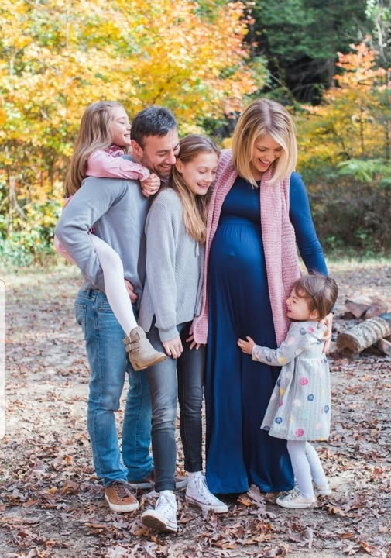
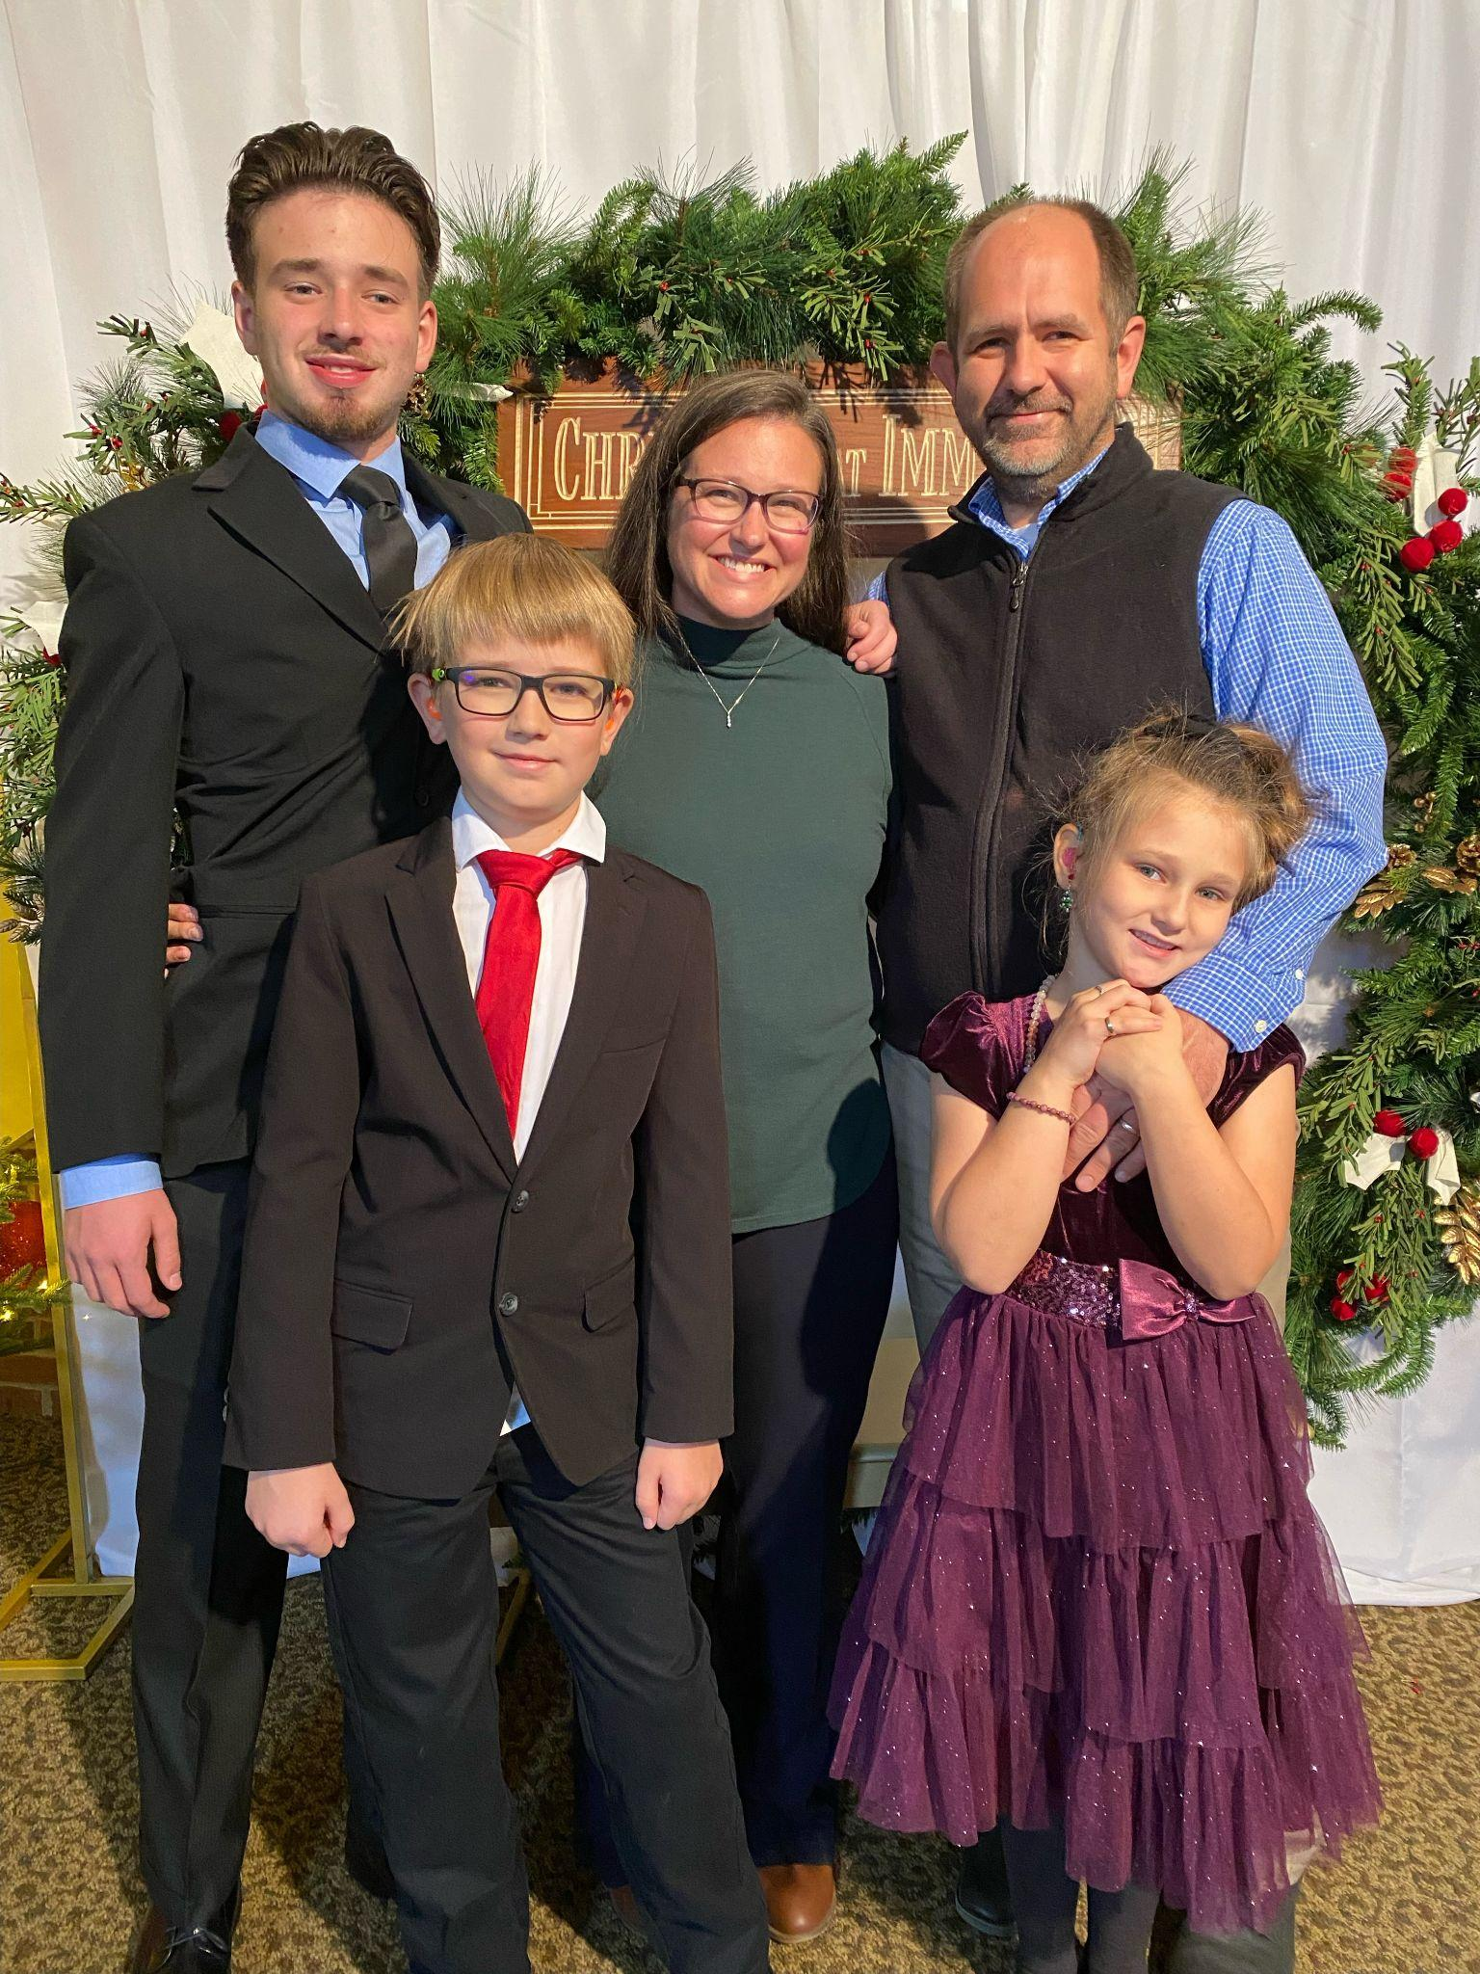
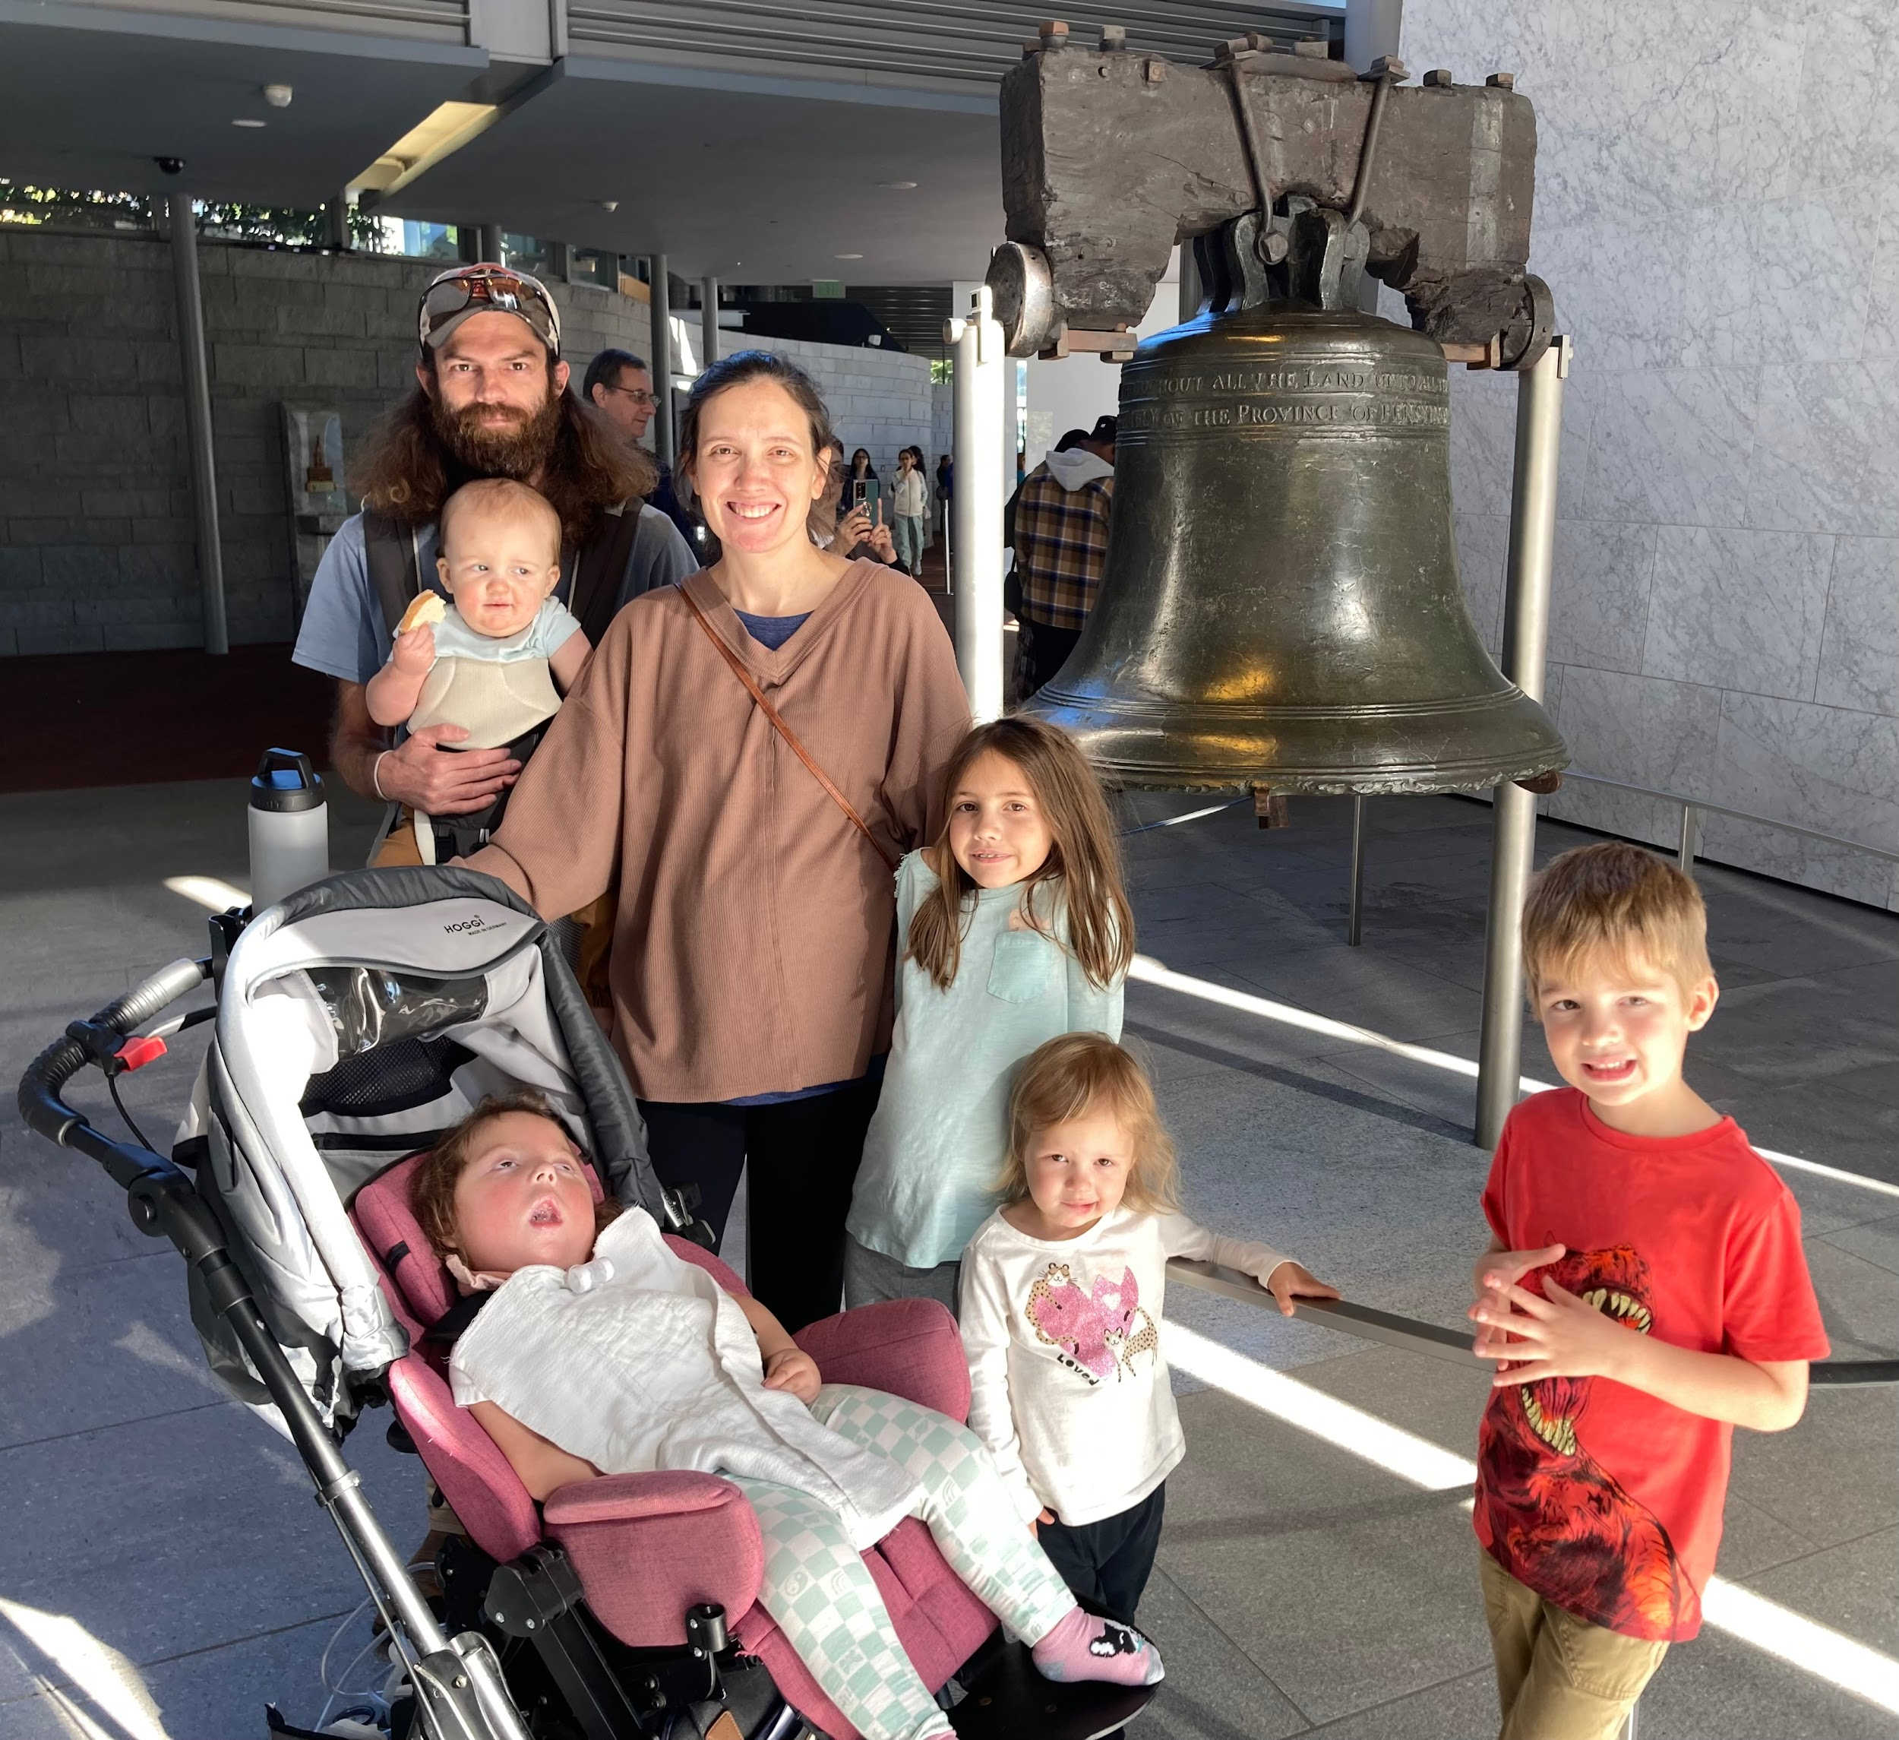
Speakers = Families
The Warren Family
The Elkins Family
The Campbell Family
The Thomas Family

Slide 4
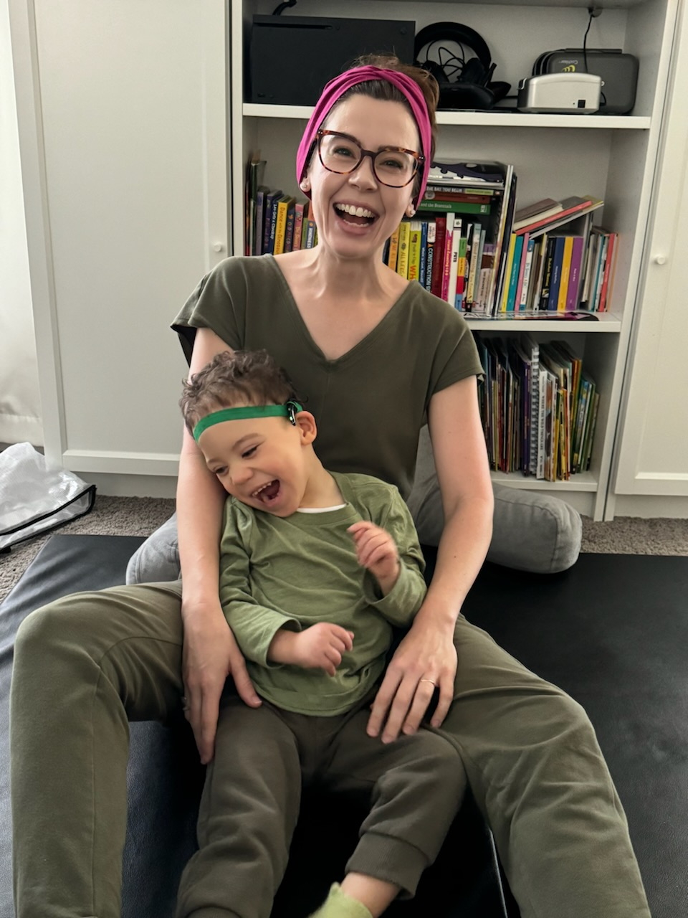
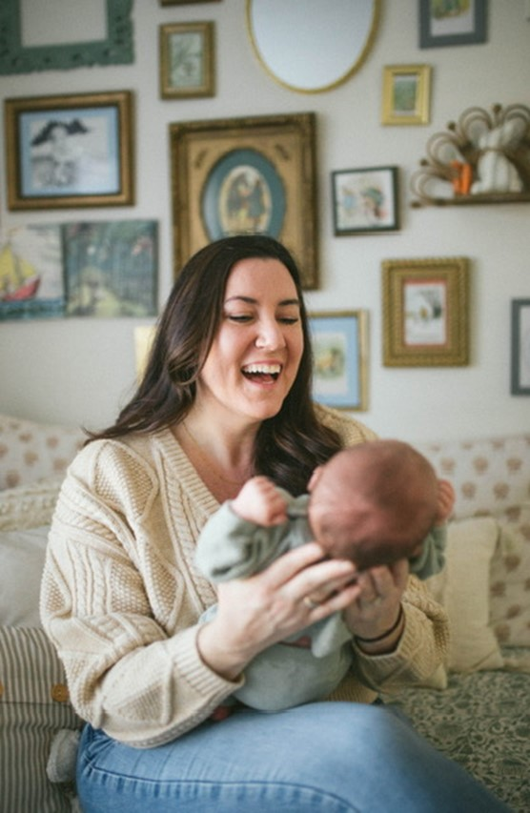
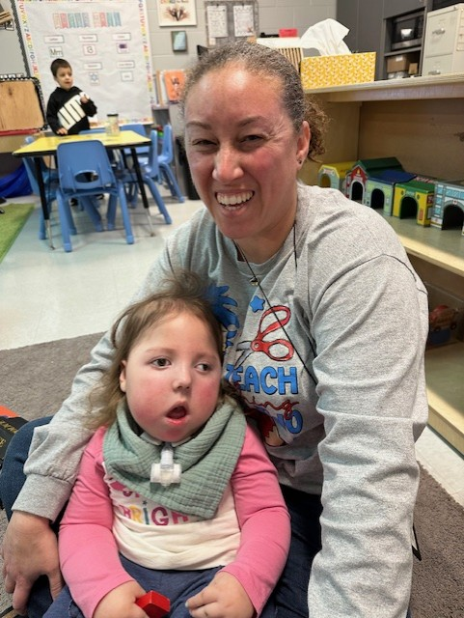
Speakers = Practitioners
Paige Maynard
Natalie Jones
Lachel Barnett

Slide 5
Learning Objectives
Participants will:
Recognize the diverse experiences during transition from early intervention to preschool of families who have children with vision and hearing differences
Learning from the family stories and identify the key elements of challenges and successes in the transition process
Utilize family-centered strategies, tools, and resources
Notes:
Info to audience about triggers and taking a breathe personal impact We embrace you to have questions…during break and different spots Donna

Slide 6
Amanda’s Story
Notes:
What did you hear? Write some notes while listening Can you imagine what deafblind is? Before Robert

Slide 7
What did we hear?
Notes:
Chart paper or sticky notes Robert

Slide 8
What is DeafBlind?
Activity
Notes:
Respect - Trust Danna prep and debrief

Slide 9
What is Deafblindness?
Combined Vision and Hearing Loss of any level
Combination of distance senses = deaf TIMES blind
Lowest of the low incidence disabilities
Approximately 11,134 children birth - age 22 in the US
Approximately 79% have additional disabilities
Disability of access
2023 National Deafblind Child Count
Notes:
Emma

Slide 10
Causes of Deafblindness
Unknown Etiology
Complications of Prematurity
Hereditary
CHARGE syndrome
Stickler syndrome
Dandy-Walker syndrome
Usher syndrome
Down syndrome
Prenatal/Congenital Complications
cCMV
Microcephaly
Hydrocephalus
Prenatal exposure to drugs or alcohol
Postnatal/Non-Congenital
Lack of oxygen
Birth Complications
Meningitis
Trauma to the brain
Notes:
Emma

Slide 11
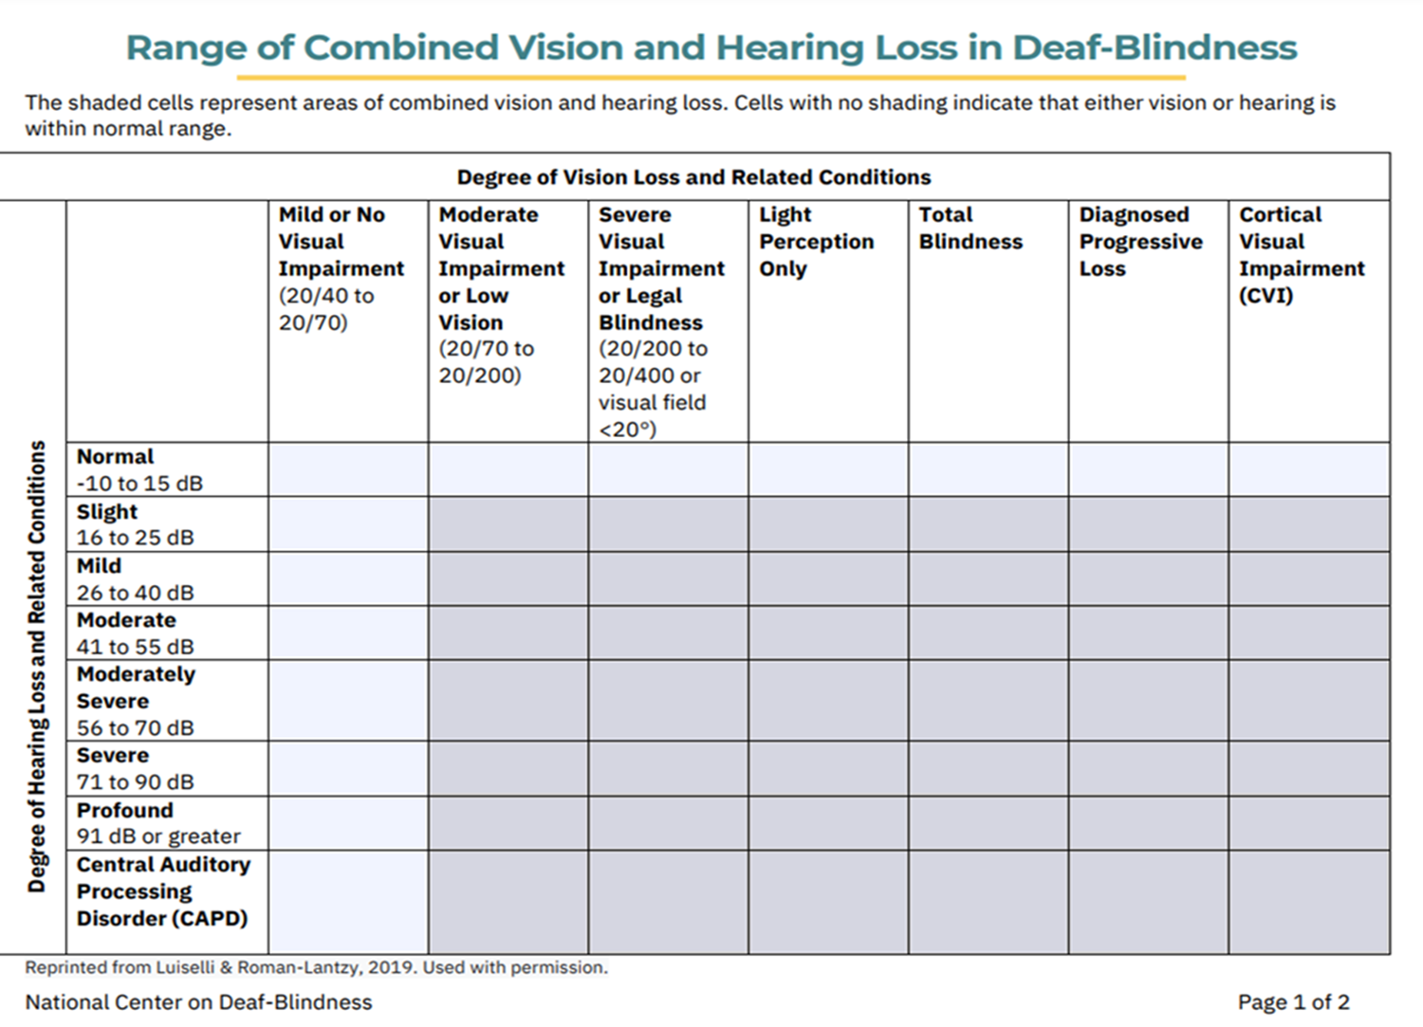
Notes:
Emma

Slide 12
Common Conditions Associated with CVI
90% Microcephaly | 15% Autism
70% Cerebral Palsy | 40% Prematurity
64% Epilepsy | 20% Genetic Anomalies
60% Optic Nerve Hypoplasia | 20% CMV
52% Delayed auditory response | 15% Down Syndrome
50% Traumatic Brain Injury | 15% Meningitis
Suzanne Dinwiddie, CTVI
Vanderbilt CVI Clinic, 2025
Notes:
Danna

Slide 13
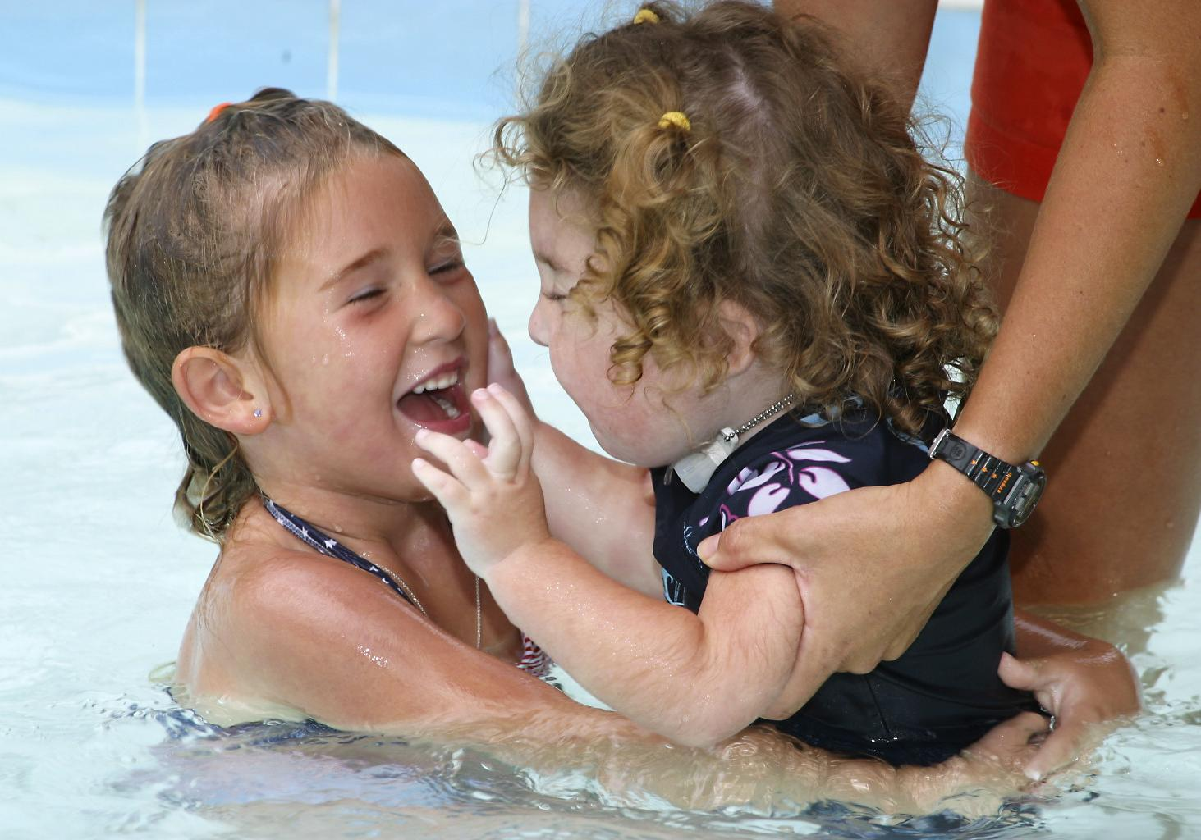
The Importance of Deafblindness in the Transition to Preschool
Deafblindness and the impact on learning
Access to information to learn & grow
Identification and preparation
Growth and development of the child throughout the lifespan
Presume competence - from early intervention to school age to graduation from high school.
Diversity of Deafblindness impacts transition
Notes:
Danna

Slide 14
Lachel’s Story
Notes:
Prep donna

Slide 15
Diversity of Families
Notes:
Embracing their trauma associated with it but so quickly embracing it….contrast to other families - set up Kelsey and Craig’s story of acceptance donna

Slide 16
Kelsey & Craig’s Story

Slide 17
Break - 15 min

Slide 18
Jake & Hillary’s Story

Slide 19
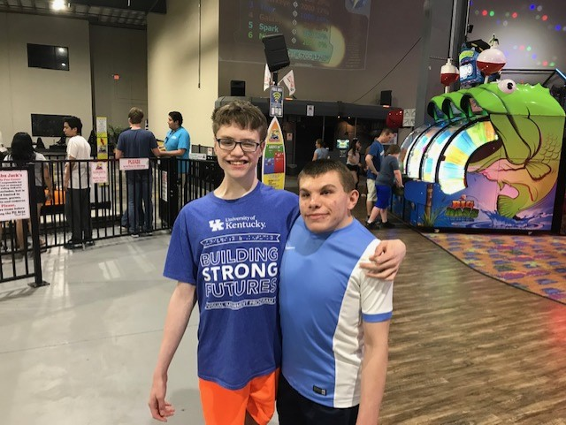
Let’s Talk! (1 of 2)
Children who are DeafBlind require specialized teaching strategies to help access their environment & learn
Referral to your state deafblind project can support children with deafblindness and their families across environments to learn these skills strategies
Notes:
Robert - what can a SDBP do for you Provide info on access to environment, people, activities…concept development Can we add some pictures of older students to stress early identification changes that path to a happy life.

Slide 20
Let’s Talk! (2 of 2)
Training & resources can provide providers and families tools to:
Help young children learn how to access residual vision and hearing
Learn skills to support the child’s learning, communication, social emotional development, motor development and increase independence
Notes:
Robert

Slide 21
Paige’s Story
Notes:
Corinne worked with Paige…she does not see lots of children who are DeafBlind

Slide 22
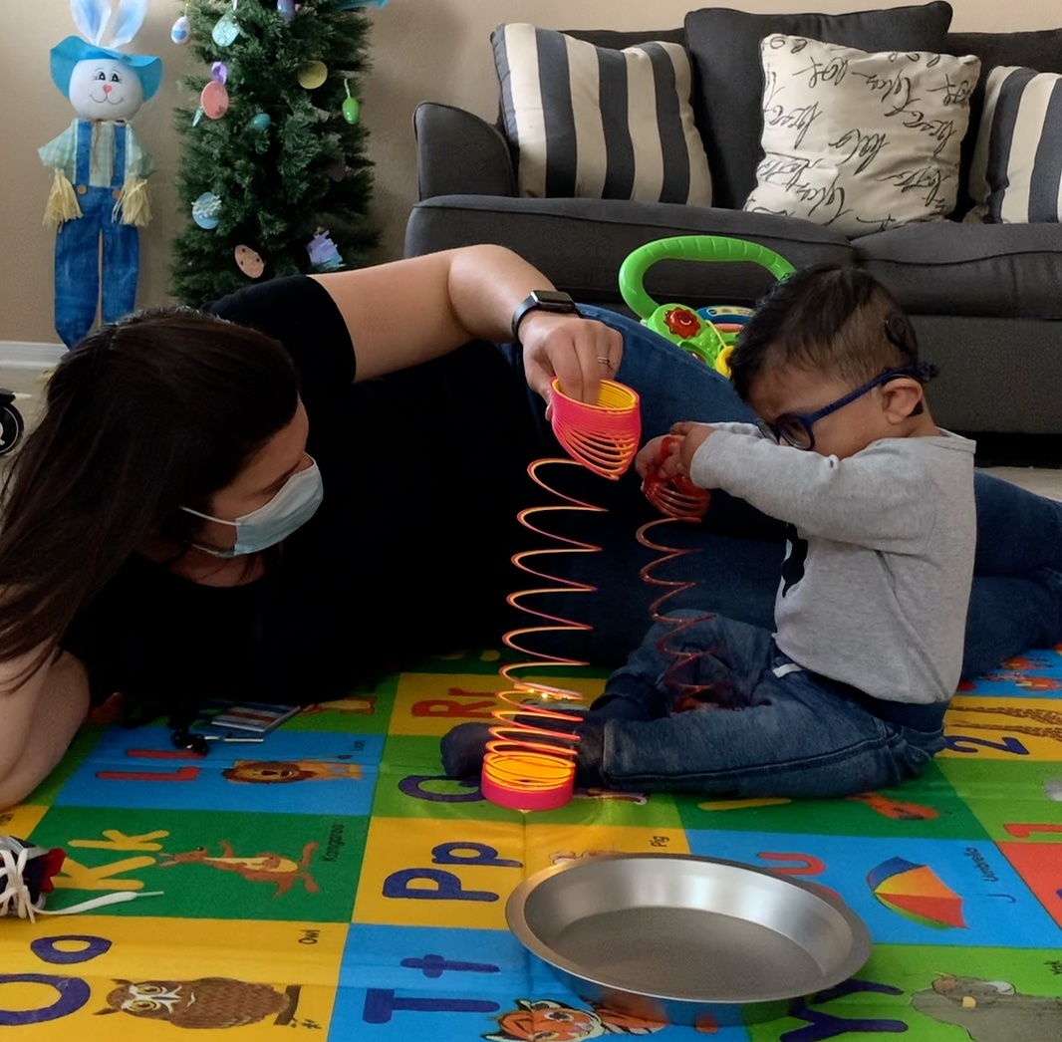
Parenting Children with Complex Needs
Navigating Medical Complexities
Learning and Growth
Comparison and Perspective
Grief
Change from the medical system to the educational system
Deafblind isn’t a diagnosis
Early intervention and advocacy (developmental reasons & purposes for early ID)
Notes:
These are some of the themes - Danna

Slide 23
Natalie’s Story

Slide 24
Lissa’s Story

Slide 25
Discussion

Slide 26
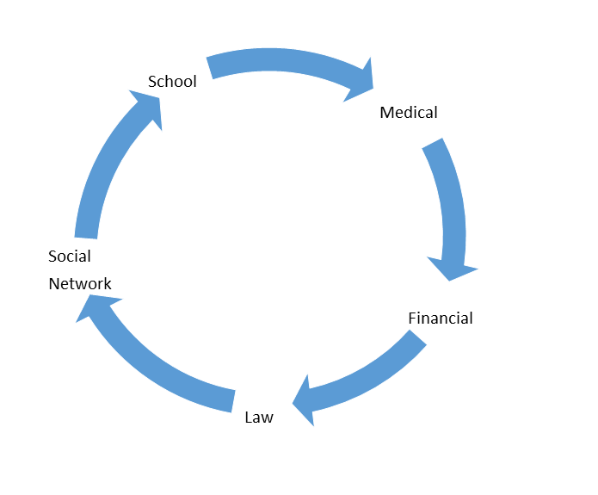
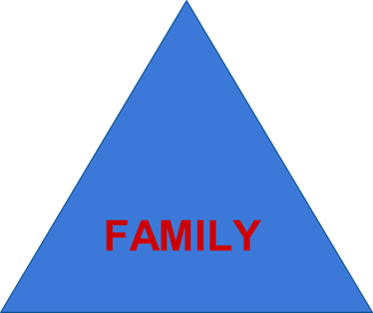
Family-Centered Approach and Meeting Families Where They Are
Factor in the ongoing and/or intermittent grief and trauma
Notes:
Paige

Slide 27
Contact Information
Kentucky
DB Project: Donna Carpenter
Jake and Hilary Warren
Craig and Kelsey Thomas
Paige Maynard
Lachel Barnett
South Carolina
DB Project: Robert Hill
Amanda Campbell
Natalie Jones
Tennessee
DB Project: Danna Conn
Lissa Elkins
National Center on Deafblindness
Emma Fricke

Slide 28
Resources (1 of 2)
Transition to Preschool: Helpful Tips for Families
Preschool Transition Planning Checklist
Key Topics for Families: Preparing for Transition to Preschool
Transitioning from Early Intervention to Preschool Webpage on National Center on Deafblindness
Teaching Children who are Deafblind: Professional Development for Educators
Lesson 4: Preparing for Transition to Preschool

Slide 29
Resources (2 of 2)
Families!
Reach for the Stars
NEC Society
Little Bear Sees
IDEA Statute
IEP Team Discussion Guide

Slide 30
Partners
Parent Training Information Centers
Hands & Voices
Family Voices
Contact Your State Deafblind Project

Slide 31
Contact Information for Your State Deafblind Project
Notes:
Emma

Slide 32
The contents of this presentation were developed under a grant from the U.S. Department of Education, #H326T230030, Project Officer, Rebecca Sheffield. However, those contents do not necessarily represent the policy of the U.S. Department of Education, and you should not assume endorsement by the Federal Government.

