Slide 1
Statewide OAE Trainings for Early Intervention Evaluations
EHDI 2025

Slide 2
Non-disclosure
No relevant financial or non-financial disclosures related to this presentation
No conflicts of interest to disclose
Free from any financial or commercial bias

Slide 3
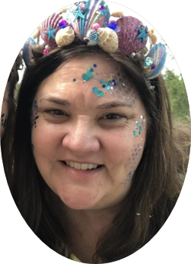
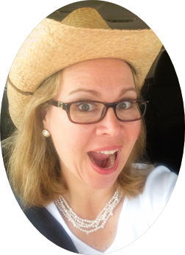
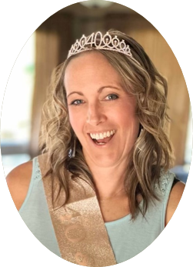
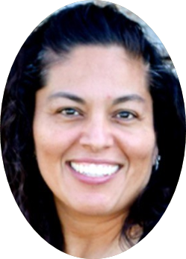
This is our team.
Dr. Dawn O’Brien
Valerie Abbott
Ashley Renslow
Sonia Samaniego
Pediatric Audiologist
NorthStar Audiology
Colorado
Parent and Author
Family Outreach EI
Virginia
Early Education Coordinator
Colorado School for the Deaf and the Blind
Early Education Service Provider
F.A.C.E.S. of Arizona

Slide 4
Objectives
Participants will:
Learn about the benefit of OAE trainings for professionals as part of EI Evaluations
Understand the importance of the varying roles of the presenters in the training
Consider and create a similar partnership in their state to support in person screenings

Slide 5
Getting Started
Colorado’s EI System
EI Programs vs EI Evaluation Entities
Importance of our roles as presenters
Parent
Audiologist
EI Coordinator
Collaborative Partners
Importance of this training
Emphasize Objective Measures of hearing during in-person Hearing Screenings
Notes:
Laws and guidance to have audiologist as part of team
Collaborative Partners - Sonia (and then multiple states and agencies coming together)
Importance- “hook” early on with parent story

Slide 6
Content of Our Training
The Parent Perspective
Refresh our Knowledge (interactive game)
Hearing Screenings Background & Education
Hands-on-Training
Wrap-up & Questions and Door Prize
Door Prize - book by our parent author reminding them
“any age and any stage”

Slide 7
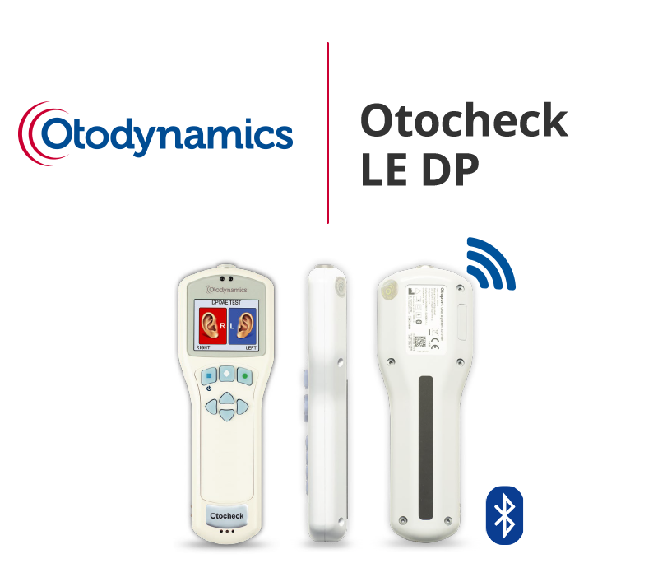
Hearing Screening Devices
Notes:
The State of Colorado invested in 40 Otodynamic Hearing Screening devices and provided training last year to over 100 EI staff with 7 different local training sites

Slide 8
Hearing Changes can happen at Any-Age and Any-Stage
~Valerie James Abbott

Slide 9
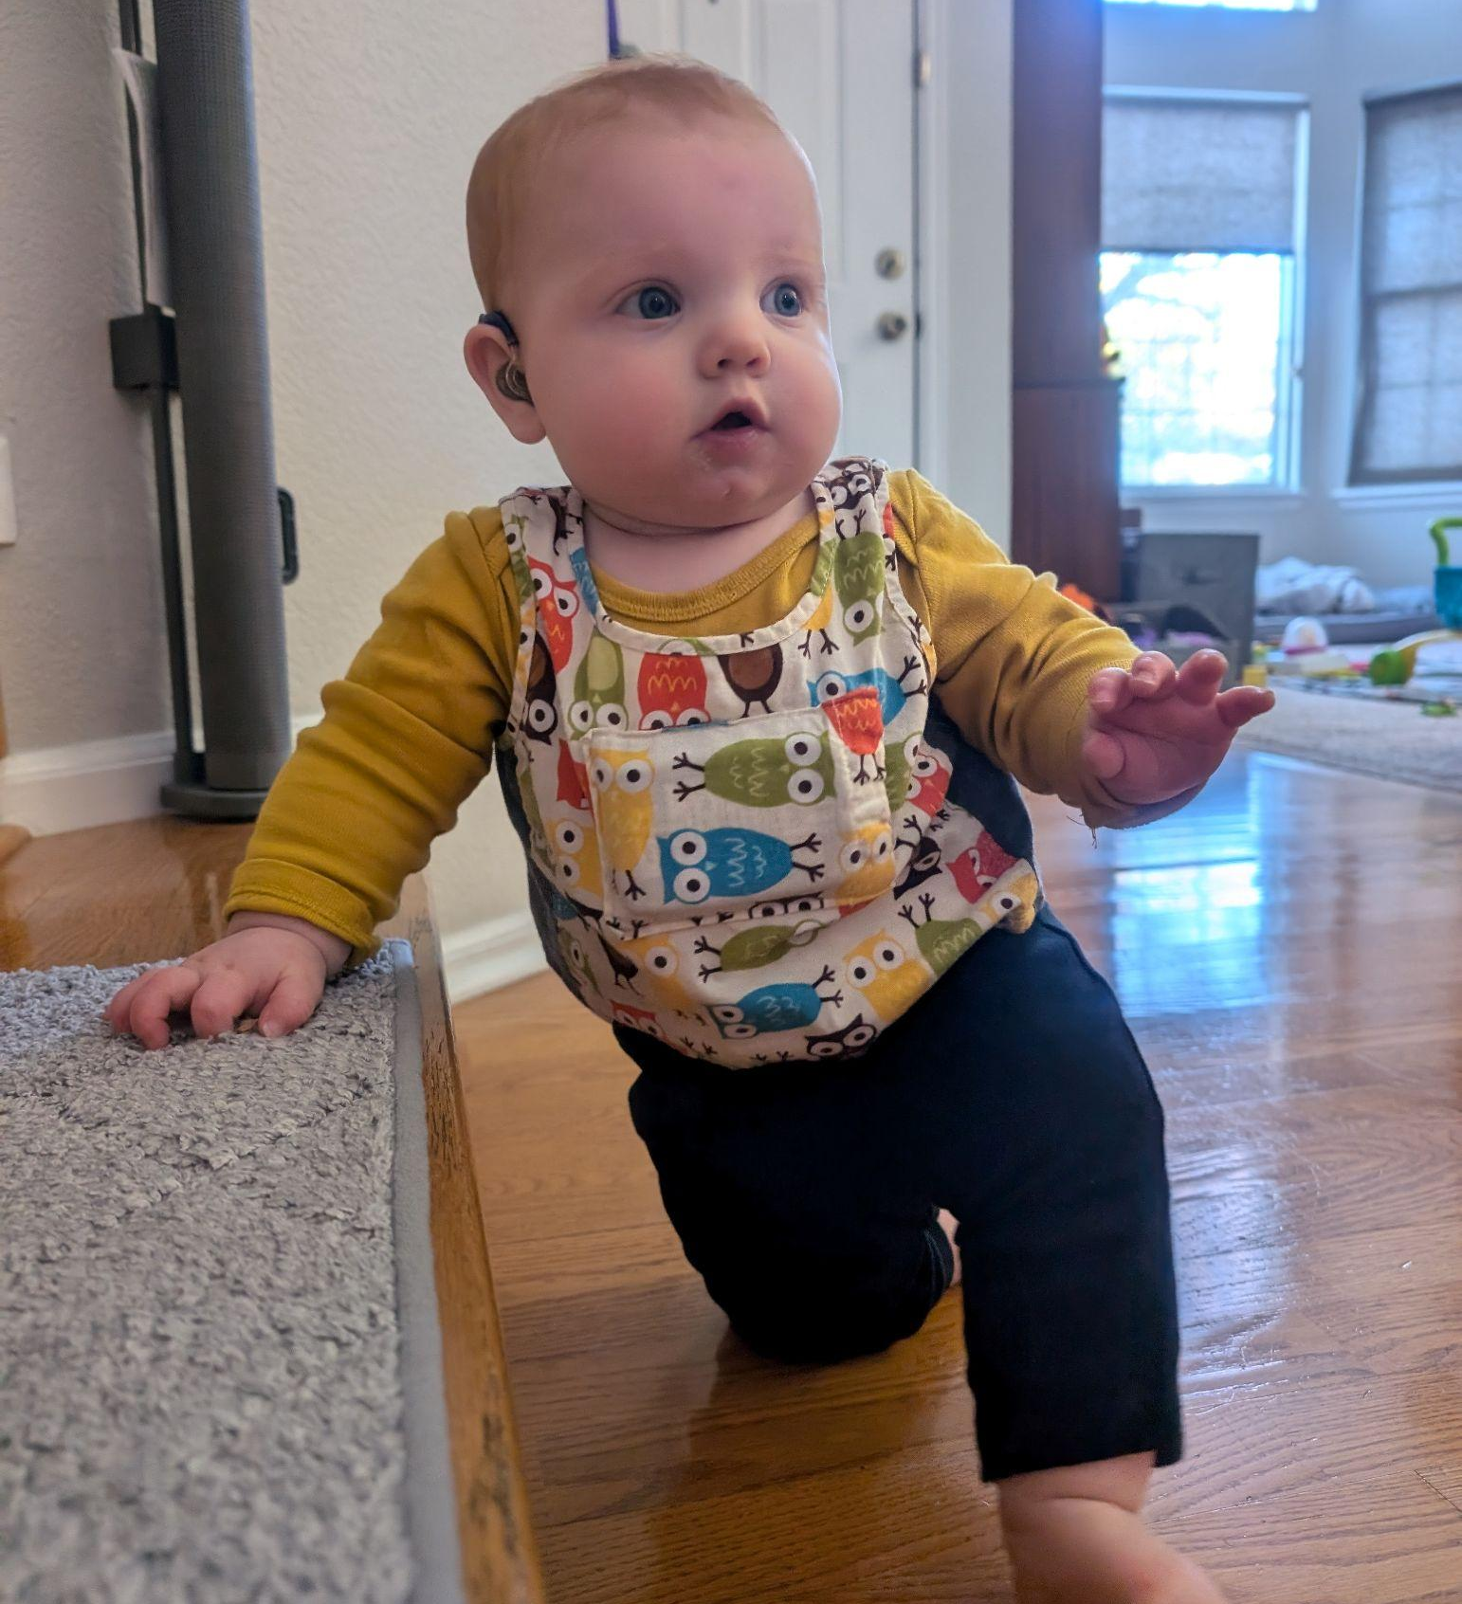
Where are we now?
Parent Collaborations (VA)
F.A.C.E.S of AZ Collaboration
University of Colorado Boulder Supplemental Videos for our trainings (be sure to stop by and see their poster)
Supporting rural areas in Colorado
Outreach Efforts: Open to sharing our work nationally
Pending follow-up opportunities for additional trainings and technical assistance in CO
Notes:
Train
Training has pointed out the parent voice - not only at the table but the first one to speak - we value the parent voice so much that we start with that!
F.A.C.E.S. - Sonia - is passionate about finding out who is doing the work for early screenings - and the importance of connecting with people in other states
**Connections**

Slide 10
Where are you now??
Notes:
Invitation to ACT - collaborate with us :)

Slide 11
EHDI Act 2017
Notes:
"The EHDI Act of 2017 extended the reach of hearing screening program, but did not result in many implemented changes." Muñoz K, Chan D, Goldberg D, Ortiz D, James Abbott V, White K. A systematic review of the prevalence of late identified hearing loss in childhood. Int J Audiol. 2025 Feb;64(2):103-110. doi: 10.1080/14992027.2024.2385550. Epub 2024 Aug 2. PMID: 39092923.

Slide 12
Q & A
Do you have any questions?
Grab a postcard on the way out for our contact information

Slide 13
Contact Information
Dawn O’Brien-Taylor northstaraudiology@gmail.com
Valerie James Abbott valeriejamesabbott@gmail.com
Ashley Renslow arenslow@csdb.org
Sonia Samaniego facesofaz@gmail.com

