Slide 1
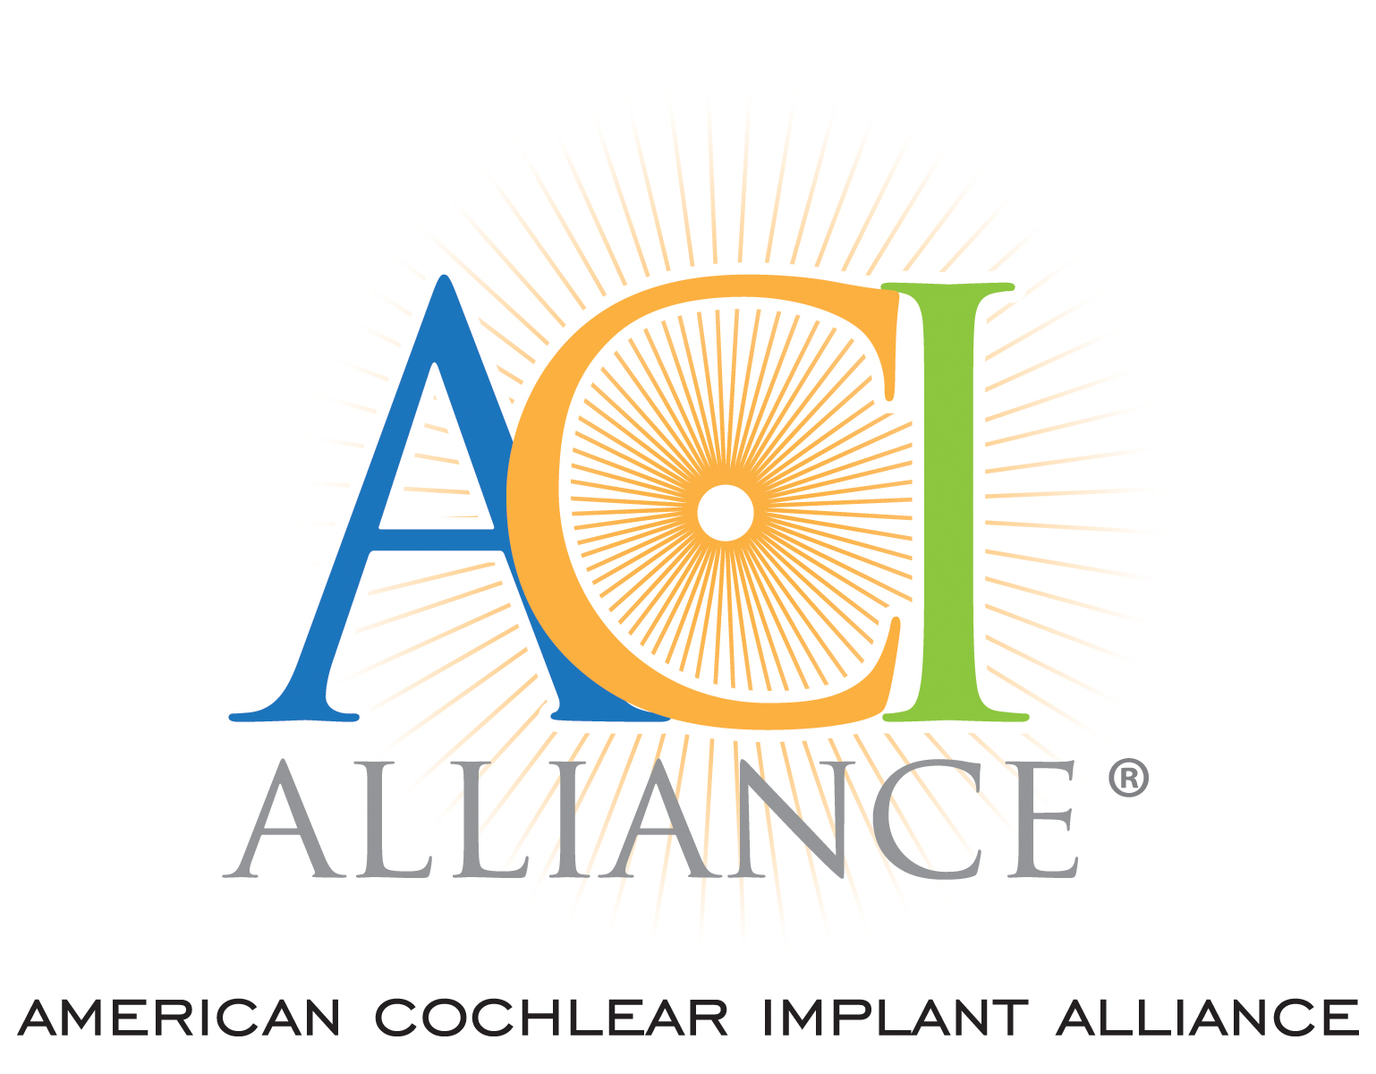
Medicaid, EPSDT, and Access to EHDI Services: Overcoming Barriers
Donna Sorkin MA Nichole westin ma
Executive Director Director of governmental affairs
dsorkin@acialliance.org nwestin@acialliance.org
American Cochlear Implant Alliance /www.acialliance.org

Slide 2
Medicaid Role in Serving Deaf & Hard of Hearing Children
Established 1967 by Congress to ensure children received appropriate healthcare services / EPSDT added later to ensure states were responding across board
Covered 37% of US children aged 19 and under in 2023*
CMS guidance on EPSDT (9/26/2024) significant
Improve outcomes by identifying and addressing health care in children—specifically mentions hearing
Acknowledges impact of poverty on health during childhood and beyond EPSDT intended to guarantee services needed
Clarifies rules apply to all states
*Statista.com
Notes:
Am J Perinatol
. 2022 Oct 28:10.1055/a-1932-9985.
doi: 10.1055/a-1932-9985. Online ahead of print.
Provider Perspectives: Identification and Follow-up of Infants who Are Deaf or Hard of Hearing
Robyn A Cree ¹ ² , Rebecca Bitsko ² , Cheri Grimm ³ , Ashley Nash ² ⁴ , Eric S Cahill ² , Eugenia Dunham ³ , Naeemah Logan ¹ ⁵ , Susannah L McKay ¹ ⁶ , David R Martinez ³ , Marcus Gaffney ²
Texas had much higher rates of failure to confirm: 73%
Results: Frequently cited barriers included problems with family access to care, difficulty contacting patients, problems with communication between providers and referrals, lack of knowledge among providers and parents, and problems using the online reporting system. Providers in rural areas more often mentioned problems with family access to care and contacting families compared to providers in urban areas.

Slide 3
Notes:
For all US children, it was 47% in 2024. Higher for children with disabilities or healthcare issues

Slide 4
Medicaid Impacts on Access to EHDI
1. 50+% D/HoH children covered by Medicaid
2. Variable payment & rules across states
3. Low reimbursement ➔ provider pool (esp rural)
4. Delay for pre-authorization
5. Managed Care Plans may not track Medicaid guidelines
6. Difficult/complex enrollment process can be overwhelming ➔ delays care
Notes:
3. If not, are they more restrictive than straight Medicaid or private insurance?
How does enrollment challenge in the state?
4. If no, skip this questions. If yes, how long does it typically take to get a child enrolled?

Slide 6
Typical Medicaid Complexities
1. Reimbursement so low that it impacts access
2. Delays for pre-authorization
3. Managed care plans have their own rules
4. Enrollment of babies into Medicaid can be overwhelming
Notes:
3. If not, are they more restrictive than straight Medicaid or private insurance?
4. If no, skip this questions. If yes, how long does it typically take to get a child enrolled?

Slide 7
Resources
Medicaid Background related to hearing health https://www.acialliance.org/page/MedicaidMedicare
Barriers Graphic https://www.acialliance.org/page/EarlyIntervention
Impact of Medicaid on Cochlear Implant Access
Otology & Neurotology 40(3):p e336-e341, March 2019. | DOI: 10.1097/MAO.0000000000002142
Guidance from Medicaid and CHIP on best practices for adhering to EPSDT Requirements 9/26/2024 https://www.medicaid.gov/federal-policy-guidance/downloads/sho24005.pdf

