Slide 1

Opportunities in partnering EHDI with an institution of higher education
Chris Kometer M.Ed, LSLS Cert AVEd & Lynn Gilbertson, PhD
Wisconsin Sound Beginnings
University of Wisconsin-Whitewater

Slide 2
Learner-Centered Outcomes
Identify three specific program enhancement opportunities resulting from a higher education partnership
1
2
List three challenges resulting from a higher education partnership
Integrate parts of the presented framework into other EHDI programs
3

Slide 3


WI EHDI System Structure
DHH-specific multidisciplinary team
Virtual joint visits
CAREs
Parents with lived experience
Young adults with lived experience
PROs
GREATs
Birth to 3
Primary coach approach
State Part C partnership

Slide 4
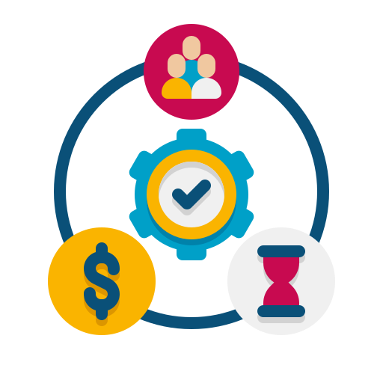
Why partner EHDI with Higher Ed?
Share resources
  People power: students, admin, clients, network
  Space: Clinical, instructional, recreational, storage
  Technology
  Expenses
Share mission/strategic priorities

Slide 5
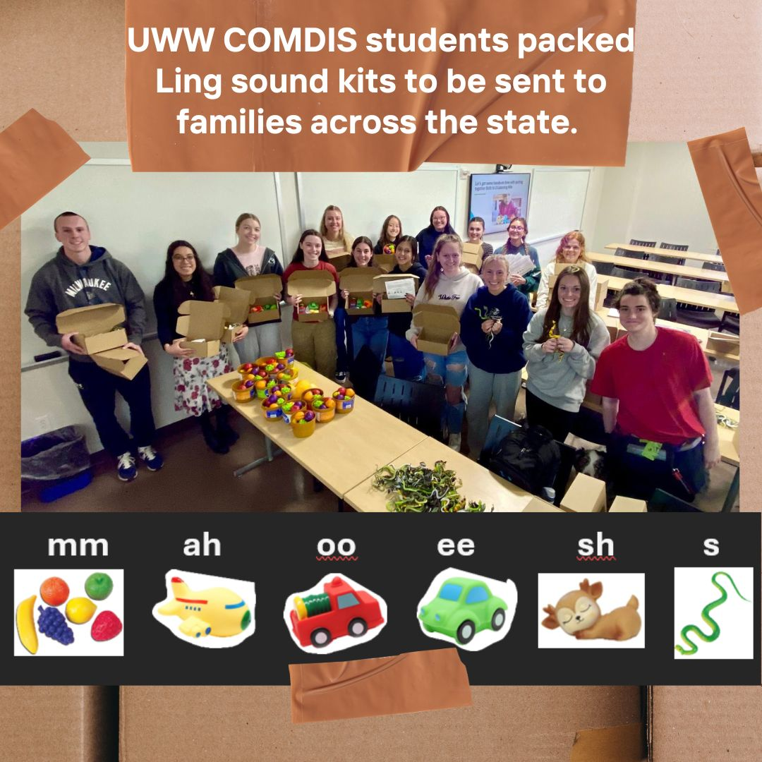

Example: Develop Parent/Caregiver Materials
Students packaged 100 Ling sound kits to be mailed to families in less than 30 minutes; ASL kits this spring
Opportunity: saved time
Challenge: coordinate with class schedule & learning outcomes

Slide 6

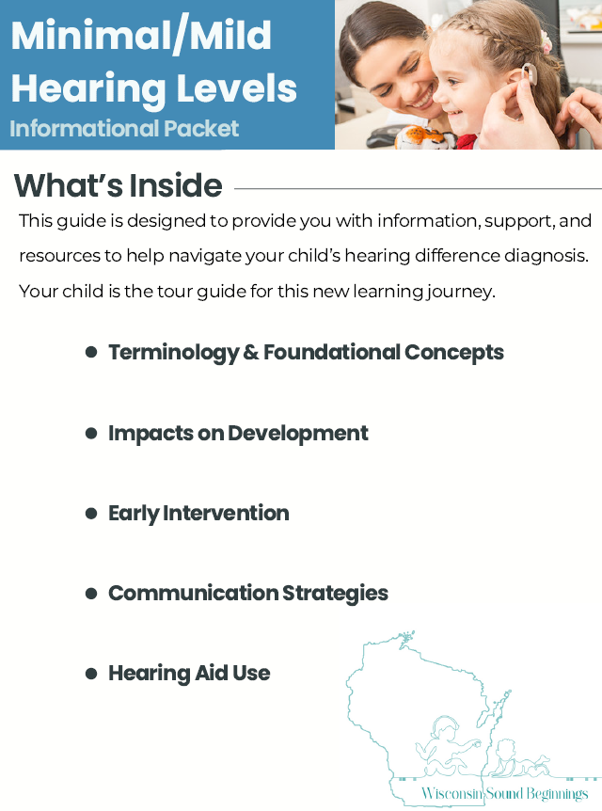

Example: Develop Parent/Caregiver Materials
Students developed two parent handouts.
Opportunity: “Outsource” design and development
Challenge: varying levels of guidance needed & schedule coordination
Microtia/Atresia Packet
MHL Packet

Slide 7
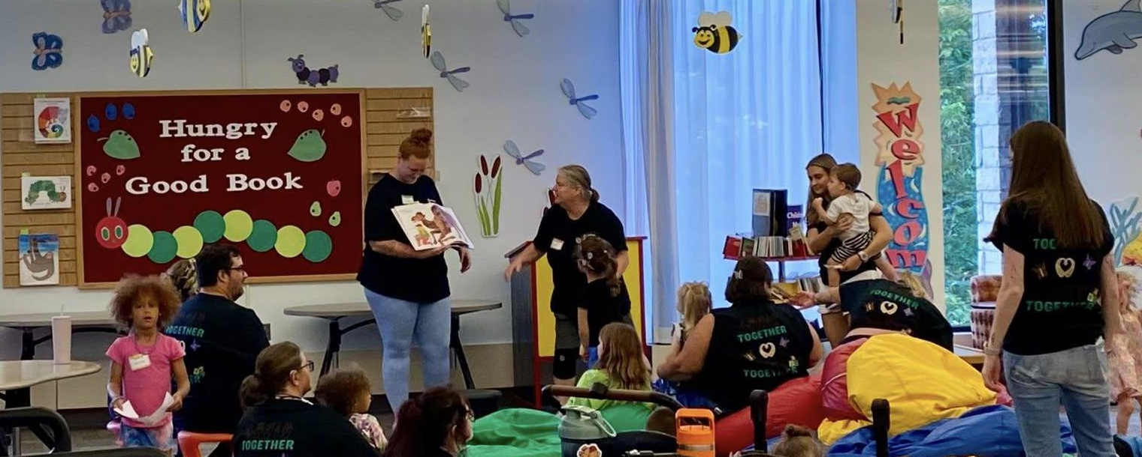

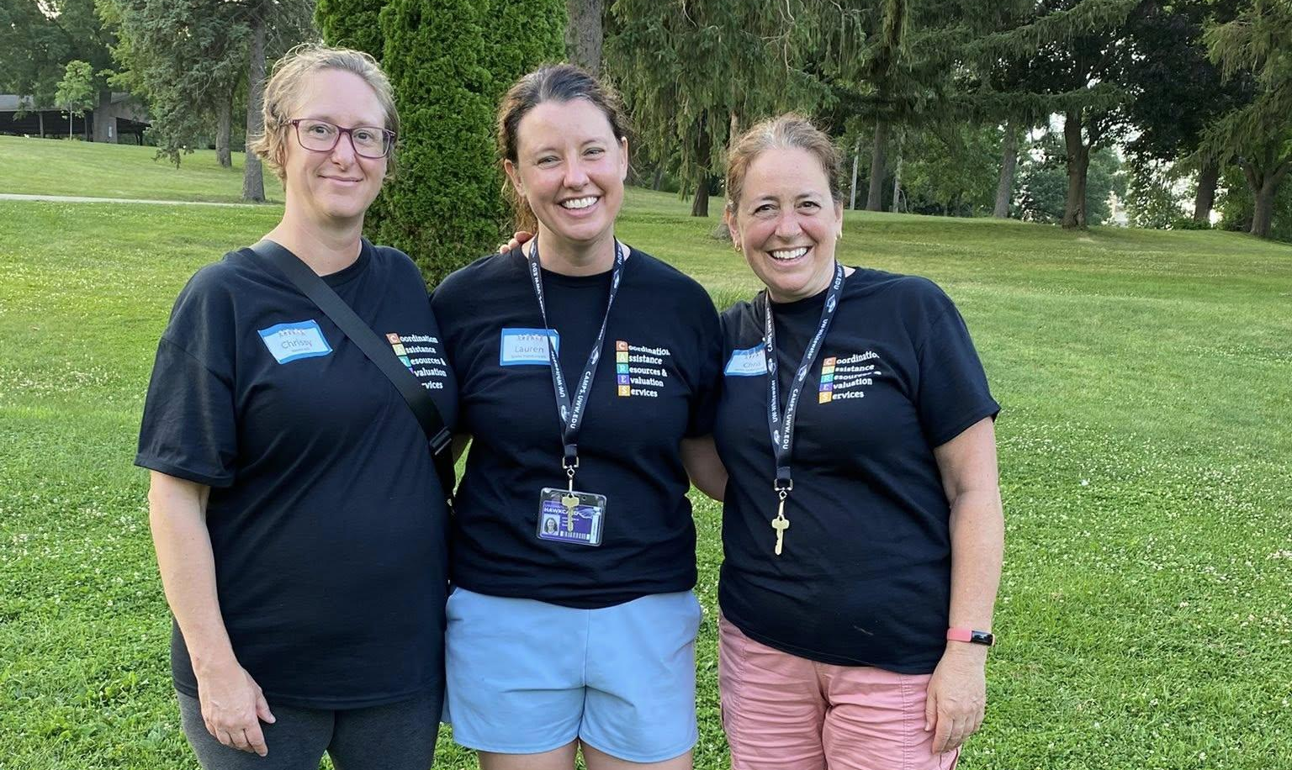
Example: Family Event
Host an overnight 3 day family language immersion event on campus
Opportunity: accessible space, affordable (lodging, meals, rentals) , registration management
Challenge: campus policy, mismatch in ages served

Slide 8

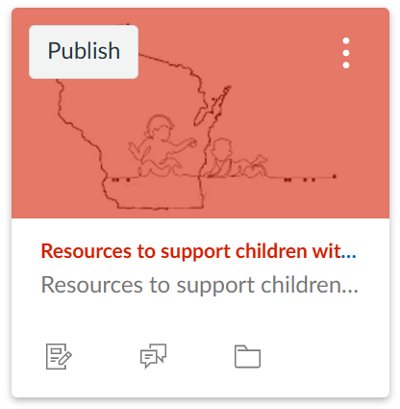

Example: Virtual Training
Professional education and development through the campus learning management system
Opportunity: access learning technology resources
Challenge: course access restrictions/management

Slide 9


Example: Access to Related Fields
Present at UWW annual early childhood conference.
Opportunity: Large audience of childcare providers/supports across WI
Challenge: fitting into established groups and events, communicating relevance and importance of work

Slide 10

Example: Shared Mission
“To act as a resource for the University and community by serving as consultants, facilitators and authorities in the various areas of communication disorders.”
Opportunity: shared understanding and alignment of expertise, mission, and strategic planning
Challenge: both programs situated in complex systems; adding a layer of bureaucracy
UWW COMDIS Dept Vision

Slide 11

Assessment Data
100 Ling kits ready for mailing
2 specific parent resources
15 families participated in family event
  parents indicated that they would like to attend again/hope it becomes an annual event
  positive affirmation such as “was a great experience” or “I wish it could have been longer.”
1 virtual training course in development
1 early childhood presentation

Slide 12

Questions

